Slide 1
“It's a Trap!”-How Speculation Invariance Can Be Abused with Forward Speculative Interference
Pavlos Aimoniotis
Christos Sakalis
Magnus Själander (@ NTNU)
Stefanos Kaxiras

Slide 2
What I’m going to tell you:
Lifting defenses from speculative-invariant instructions is dangerous!
In this talk:
Speculative defenses: e.g.: delay-on-miss (DoM)
Speculative invariance: lifting these defenses for bound-to-commit instructions
Speculative interference: speculative instructions interfering with non-speculative instructions OR …
…. interfering with bound-to-commit instructions using a novel side-channel (ROB contention)
Demonstrate ROB contention on unprotected cores
Propose ways to address problem (WIP)
{
Our contributions
Notes:
(instructions that are bound-to-commit regardless of the outcome of speculation)
Because: speculative instructions can interfere with the bound-to-commit instructions and reveal through this interference the secret

Slide 3
Delay-on-Miss
Delays transient loads until they become non-speculative
Delays only loads that miss in the cache
Allows hits in L1 Cache to execute under speculation
Delays any side-effects until load becomes non-speculative
Defenses with similar goals: Invisispec [MICRO'18], GhostLoads [CF'19], Muontrap [ISCA'20], etc.
Question: can we lift these defenses while in speculation?

Slide 4
Speculation Invariance
Zhao et al. insight: we can lift such defenses for bound-to-commit instructions that are independent to the outcome of speculation
InvarSpec: Framework that detects speculation invariant instructions
Statically determines dependences through compiler
At runtime hardware lifts protection for speculation invariant instructions
Not entirely true …
Notes:
However, not entirely true! because speculation instr can interfere with the bound-to-commit instr
What is inteference?

Slide 5
Speculative Interference Attacks
Break defense mechanisms like DoM and Invisispec
By influencing ordering of memory operations:
“Backward” SI because younger speculative instructions interfere with older non-speculative instructions
interference_target;
if() {// mispredict
ld secret // hit
interference_gadget(secret);
}
“Backward”

Slide 6
Our contribution: Forward SI
Older speculative instructions interfere with younger bound-to-commit instructions:
ROB contention
if() {
ld secret // hit
interference_gadget(secret);
}
interference_target;
“Forward”

Slide 7
1
if()
train_branch_predictor();
if() { // mispredict
ld secret // hit
if(secret){
fill_the_ROB;
}
else
{} // nothing
}
else { // correct path
time();
load A;
time();
}
load A // bound-to-commit spec-invar
Secret
Depend.
1
0
0
ROB-Contention
ROB-Empty
meas.
ld A
Hit? Secret == 0!
Miss? Secret == 1!
ld A
ld A
ld A
ROB
No entry available.
Does not execute and
thus not brought in cache!
Available entry.
Executes and brought to cache!
ROB Contention?
Tight loop or long sequence of spurious instructions
Single static instruction
x86 ISA REP instruction: expands speculatively

Slide 8
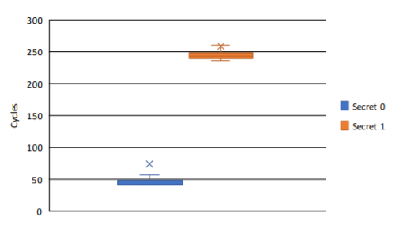
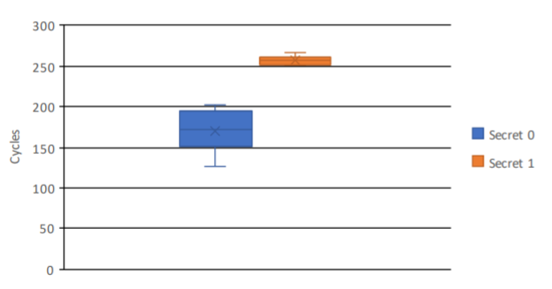
Expiremental Results
Speculation invariant instructions that lift protections are equivelant to bound-to-commit instructions on real core!
Have the same behaviour
Delaying with a for-loop
avg load on delay path 258 cycles (miss)
avg load on fast path equals 73 cycles (hit)
Delaying with REP
avg load on delay equals path 260 cycles (miss)
avg load on fast path equals 170 cycles (hit)
System
Intel Core i7-2600k, Sandy Bridge, 3.40GHz
4 Cores, 3 Cache levels
32KiB L1 Cache, 256KiB L2 Cache, 8MiB Shared-LLC
Notes:
[Interpret the results → spec-invariant become transmitters!]
STRONG SIGNAL TO DISTINGUISH THE SECRET

Slide 9
Future Work - Forward Speculative Interference Mitigations
Do not lift protections if branch paths differ under speculation!
Balance the paths
Make speculative ROB-filling operand-independent
Similar to Yu, Jiyong, et al. "Speculative data-oblivious execution: Mobilizing safe prediction for safe and efficient speculative execution." (ISCA '20)

Slide 10
Conclusion
Side-channel based on ROB contention
Speculative Interference
Forward SI
Selectively lifting protections is vulnerable
Proposed a number of mitigations

Slide 11
Thank you!

