Slide 1

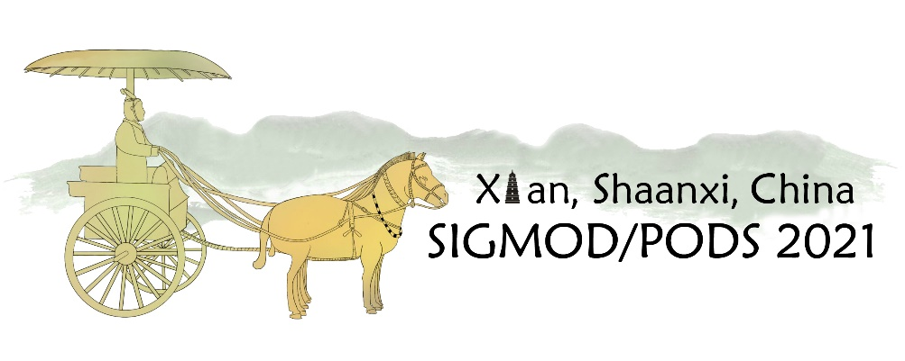

Proportionality in
Spatial Keyword Search
Georgios Kalamatianos
Uppsala University
Georgios John Fakas
Uppsala University
Nikos Mamoulis
University of Ioannina

Slide 2





Spatial Datasets
Many spatial datasets are available online
Spatial objects are associated with :
descriptive tags; linked entities.
Location based retrieval should consider context as well as location.
Gowalla
museum;
history;
vikings;

Slide 3
Example of top-3 retrieval
Example:
A query Q: {q, museum}
  A relevance query result could include p₁, p₂ and p₃.
  A diversified query result could include p₁, p₃ and p₄.
  A proportional query result could include p₁, p₂ and p₄.

Slide 4
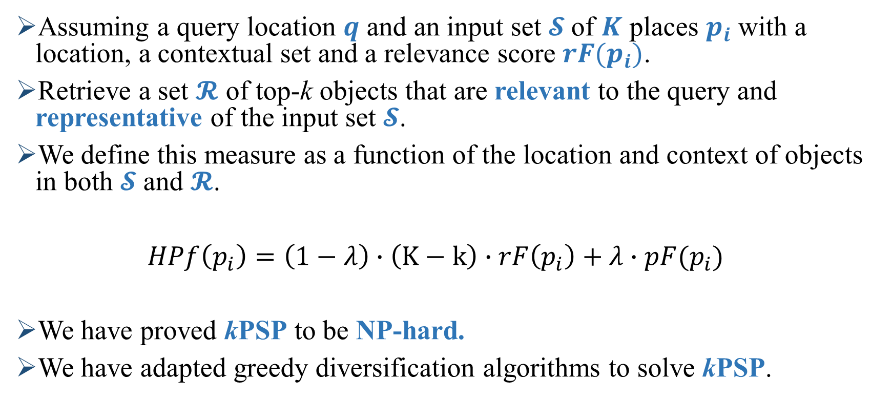
k- Proportional Semantic Places problem (kPSP)
Assuming a query location $q$ and an input set $𝓢$of $K$ places $p_{i}$ with a location, a contextual set and a relevance score $rF(p_{i})$.
Retrieve a set $𝓡$ of top-k objects that are relevant to the query and representative of the input set $𝓢$.
We define this measure as a function of the location and context of objects in both $𝓢$ and $𝓡$.
$HPf\left(p_{i}\right)=\left(1−λ\right)∙\left(K−k\right)∙rF\left(p_{i}\right)+λ∙pF(p_{i})$
We have proved kPSP to be NP-hard.
We have adapted greedy diversification algorithms to solve kPSP.
Relevance score
Proportionality score

Slide 5
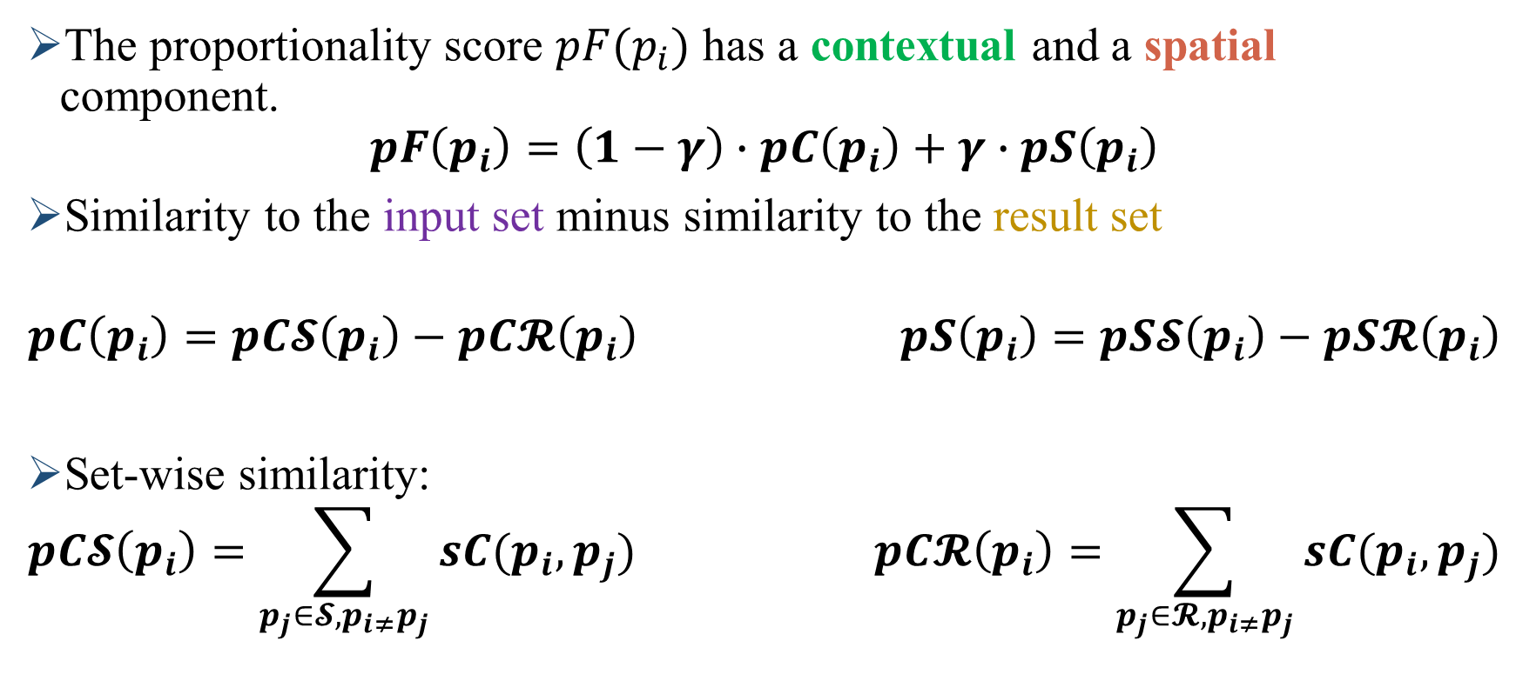
kPSP – Proportionality Components
The proportionality score $pF(p_{i})$ has a contextual and a spatial component.
$$pF\left(p_{i}\right)=\left(1−γ\right)∙pC\left(p_{i}\right)+γ∙pS\left(p_{i}\right)$$
Similarity to the input set minus similarity to the result set
$$pC\left(p_{i}\right)=pC𝓢\left(p_{i}\right)−pC𝓡\left(p_{i}\right) pS\left(p_{i}\right)=pS𝓢\left(p_{i}\right)−pS𝓡\left(p_{i}\right)$$
Set-wise similarity:
$$pC𝓢\left(p_{i}\right)=\sum_{p_{j}∈𝓢,p_{i≠}p_{j}}{sC(p_{i},p_{j})} pC𝓡\left(p_{i}\right)=\sum_{p_{j}∈𝓡,p_{i≠}p_{j}}{sC(p_{i},p_{j})}$$

Slide 6

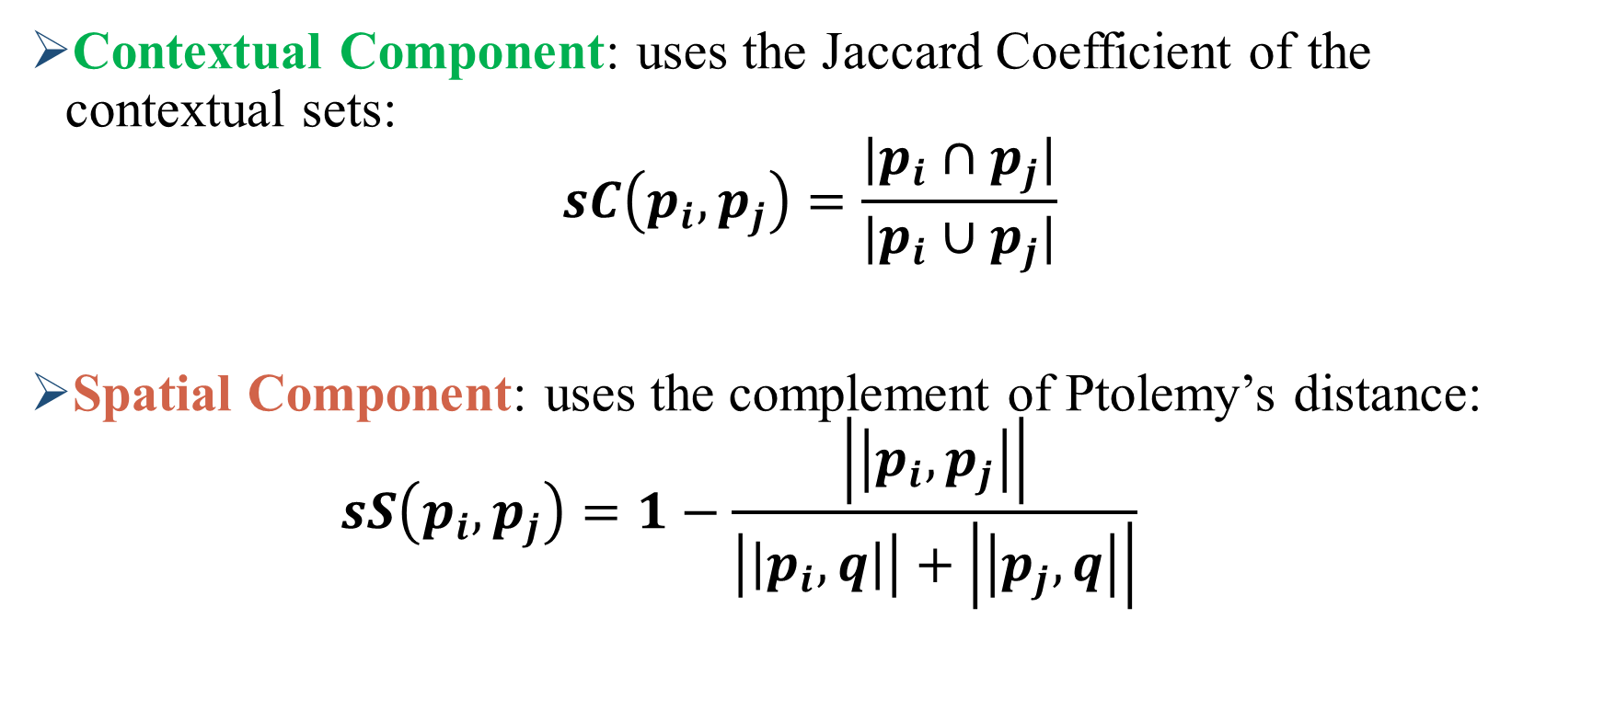

kPSP – Similarity Scores
Contextual Component: uses the Jaccard Coefficient of the contextual sets:
$$sC\left(p_{i},p_{j}\right)=\frac{|p_{i}∩p_{j}|}{|p_{i}∪p_{j}|}$$
Spatial Component: uses the complement of Ptolemy’s distance:
$$sS\left(p_{i},p_{j}\right)=1−\frac{\left|\left|p_{i},p_{j}\right|\right|}{\left|\left|p_{i},q\right|\right|+\left|\left|p_{j},q\right|\right|}$$
p₁ | a | b | c | d
p₂ | a | d
$$sC\left(p_{1},p_{2}\right)=\frac{1}{2}$$
$$sS\left(p_{1},p_{2}\right)=0. 09 \\ sS\left(p_{1},p_{3}\right)=0.07$$
$$sS\left(p_{2},p_{3}\right)=0.8$$
[Cai et al. VLDBJ, 2020]

Slide 7
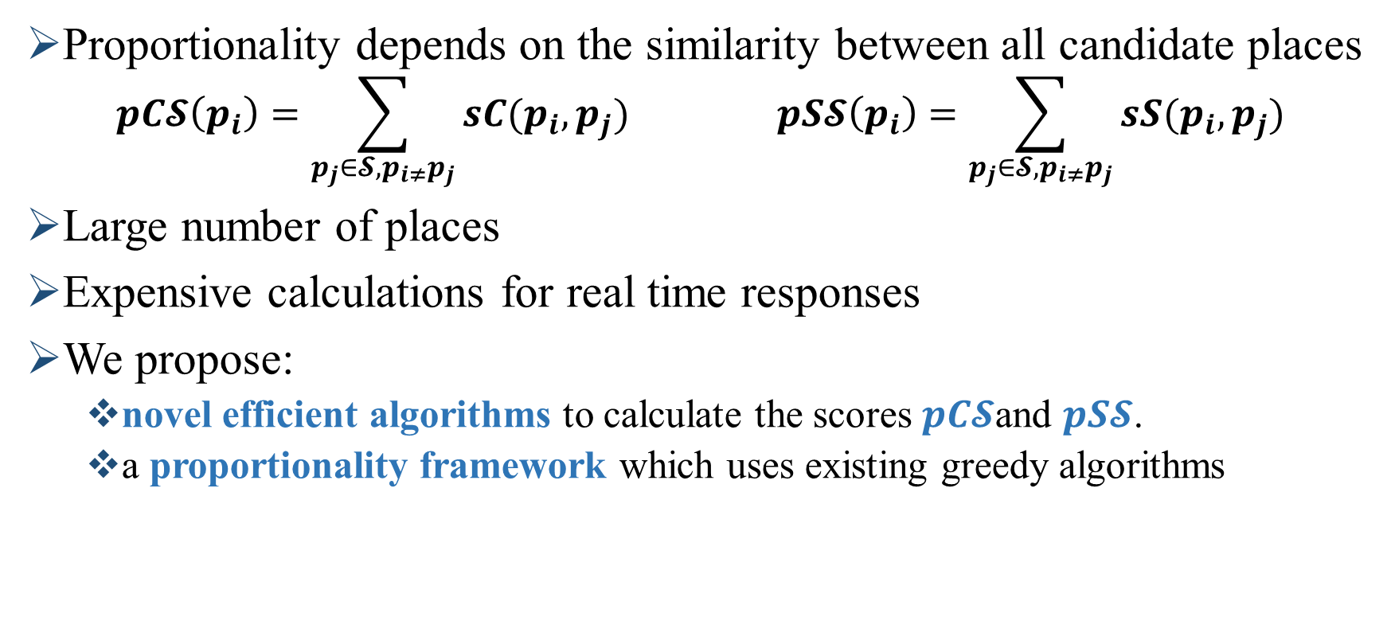
Computational Challenges
Proportionality depends on the similarity between all candidate places
$$pC𝓢\left(p_{i}\right)=\sum_{p_{j}∈𝓢,p_{i≠}p_{j}}{sC(p_{i},p_{j})} pS𝓢\left(p_{i}\right)=\sum_{p_{j}∈𝓢,p_{i≠}p_{j}}{sS(p_{i},p_{j})}$$
Large number of places
Expensive calculations for real time responses
We propose:
  novel efficient algorithms to calculate the scores $pC𝓢$and $pS𝓢$.
  a proportionality framework which uses existing greedy algorithms

Slide 8
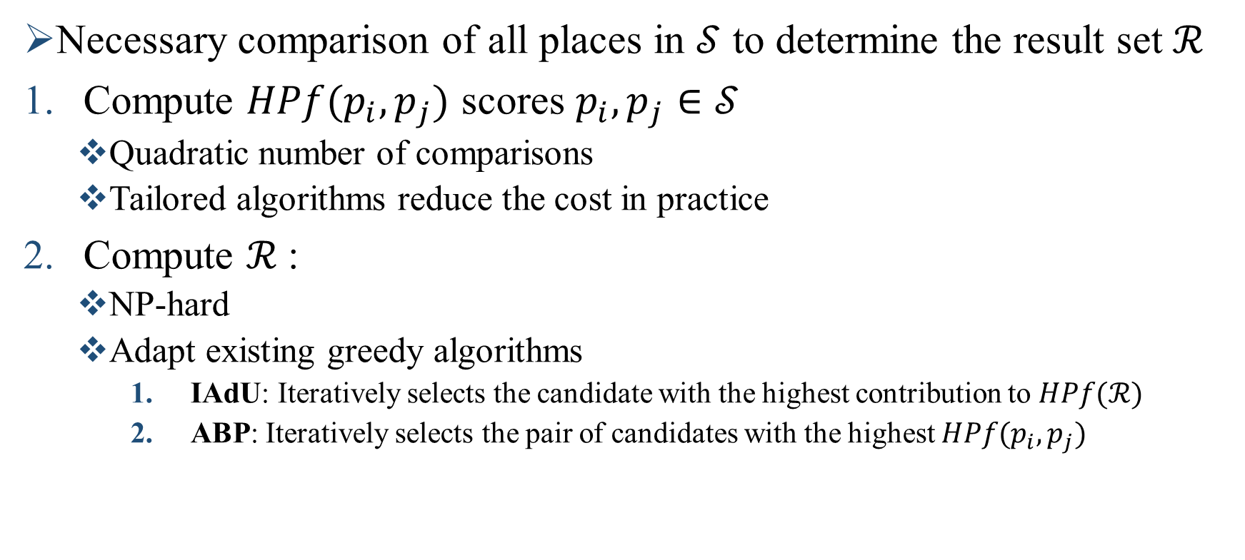
Proportionality Framework
Necessary comparison of all places in $𝒮$ to determine the result set $ℛ$
Compute $HPf(p_{i},p_{j})$ scores $p_{i},p_{j}∈𝒮$
  Quadratic number of comparisons
  Tailored algorithms reduce the cost in practice
Compute $ℛ$:
  NP-hard
  Adapt existing greedy algorithms
    IAdU: Iteratively selects the candidate with the highest contribution to $HPf(ℛ)$
    ABP: Iteratively selects the pair of candidates with the highest $HPf(p_{i},p_{j})$

Slide 9
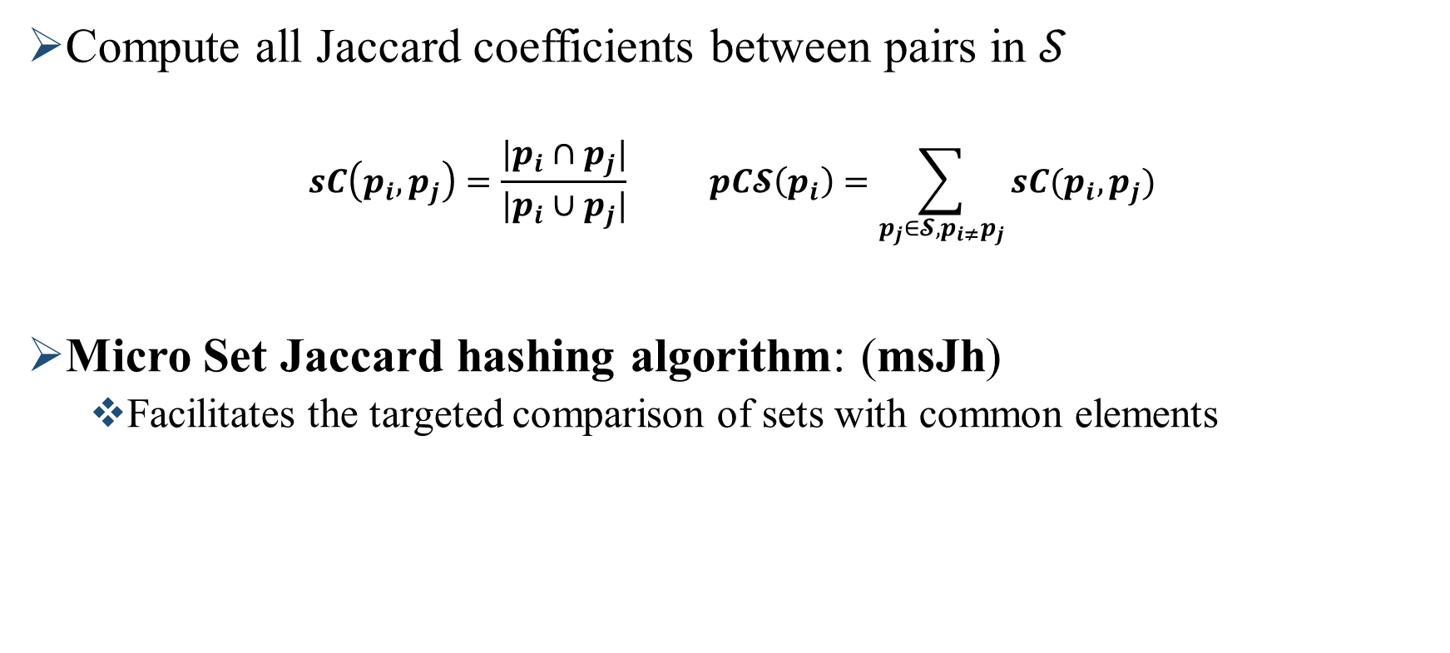
Contextual Proportionality computation
Compute all Jaccard coefficients between pairs in $𝒮$
$$sC\left(p_{i},p_{j}\right)=\frac{|p_{i}∩p_{j}|}{|p_{i}∪p_{j}|} pC𝓢\left(p_{i}\right)=\sum_{p_{j}∈𝓢,p_{i≠}p_{j}}{sC(p_{i},p_{j})}$$
Micro Set Jaccard hashing algorithm: (msJh)
  Facilitates the targeted comparison of sets with common elements

Slide 10
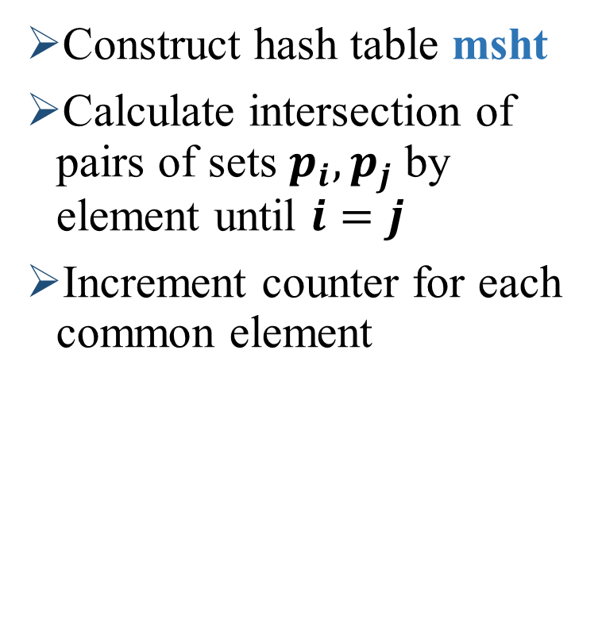
Contextual Proportionality: msJh
Construct hash table msht
Calculate intersection of pairs of sets $p_{i},p_{j}$ by element until $i=j$
Increment counter for each common element
Contextual Sets
p₁ | a | b | c | d
p₂ | a | d
p₃ | e | f | g
p₄ | a | b | h
p₅ | b | c | i
msht
Mh | Sets
a | p₄ | p₂ | p₁
b | p₅ | p₄ | p₁
c | p₅ | p₁
d | p₂ | p₁
e | p₃
f | p₃
g | p₃
h | p₄
i | p₅
 | p₁ | p₂ | p₃ | p₄ | p₅
p₁ | - | 0 | 0 | 0 | 0
p₂ | - | - | 0 | 0 | 0
p₃ | - | - | - | 0 | 0
p₄ | - | - | - | - | 0
p₅ | - | - | - | - | -

Slide 11
Contextual Proportionality: msJh
Construct hash table msht
Calculate intersection of pairs of sets $p_{i},p_{j}$ by element until $i=j$
Increment counter for each common element
Contextual Sets
p₁ | a | b | c | d
p₂ | a | d
p₃ | e | f | g
p₄ | a | b | h
p₅ | b | c | i
msht
Mh | Sets
a | p₄ | p₂ | p₁
b | p₅ | p₄ | p₁
c | p₅ | p₁
d | p₂ | p₁
e | p₃
f | p₃
g | p₃
h | p₄
i | p₅
 | p₁ | p₂ | p₃ | p₄ | p₅
p₁ | - | 0 | 0 | 0 | 0
p₂ | - | - | 0 | 0 | 0
p₃ | - | - | - | 0 | 0
p₄ | - | - | - | - | 0
p₅ | - | - | - | - | -

Slide 12
Contextual Proportionality: msJh
Construct hash table msht
Calculate intersection of pairs of sets $p_{i},p_{j}$ by element until $i=j$
Increment counter for each common element
Contextual Sets
p₁ | a | b | c | d
p₂ | a | d
p₃ | e | f | g
p₄ | a | b | h
p₅ | b | c | i
msht
Mh | Sets
a | p₄ | p₂ | p₁
b | p₅ | p₄ | p₁
c | p₅ | p₁
d | p₂ | p₁
e | p₃
f | p₃
g | p₃
h | p₄
i | p₅
 | p₁ | p₂ | p₃ | p₄ | p₅
p₁ | - | 0 | 0 | 1 | 0
p₂ | - | - | 0 | 0 | 0
p₃ | - | - | - | 0 | 0
p₄ | - | - | - | - | 0
p₅ | - | - | - | - | -

Slide 13
Contextual Proportionality: msJh
Construct hash table msht
Calculate intersection of pairs of sets $p_{i},p_{j}$ by element until $i=j$
Increment counter for each common element
Contextual Sets
p₁ | a | b | c | d
p₂ | a | d
p₃ | e | f | g
p₄ | a | b | h
p₅ | b | c | i
msht
Mh | Sets
a | p₄ | p₂ | p₁
b | p₅ | p₄ | p₁
c | p₅ | p₁
d | p₂ | p₁
e | p₃
f | p₃
g | p₃
h | p₄
i | p₅
 | p₁ | p₂ | p₃ | p₄ | p₅
p₁ | - | 1 | 0 | 1 | 0
p₂ | - | - | 0 | 0 | 0
p₃ | - | - | - | 0 | 0
p₄ | - | - | - | - | 0
p₅ | - | - | - | - | -

Slide 14
Contextual Proportionality: msJh
Construct hash table msht
Calculate intersection of pairs of sets $p_{i},p_{j}$ by element until $i=j$
Increment counter for each common element
Contextual Sets
p₁ | a | b | c | d
p₂ | a | d
p₃ | e | f | g
p₄ | a | b | h
p₅ | b | c | i
msht
Mh | Sets
a | p₄ | p₂ | p₁
b | p₅ | p₄ | p₁
c | p₅ | p₁
d | p₂ | p₁
e | p₃
f | p₃
g | p₃
h | p₄
i | p₅
 | p₁ | p₂ | p₃ | p₄ | p₅
p₁ | - | 1 | 0 | 1 | 1
p₂ | - | - | 0 | 0 | 0
p₃ | - | - | - | 0 | 0
p₄ | - | - | - | - | 0
p₅ | - | - | - | - | -

Slide 15
Contextual Proportionality: msJh
Construct hash table msht
Calculate intersection of pairs of sets $p_{i},p_{j}$ by element until $i=j$
Increment counter for each common element
Contextual Sets
p₁ | a | b | c | d
p₂ | a | d
p₃ | e | f | g
p₄ | a | b | h
p₅ | b | c | i
msht
Mh | Sets
a | p₄ | p₂ | p₁
b | p₅ | p₄ | p₁
c | p₅ | p₁
d | p₂ | p₁
e | p₃
f | p₃
g | p₃
h | p₄
i | p₅
 | p₁ | p₂ | p₃ | p₄ | p₅
p₁ | - | 1 | 0 | 2 | 1
p₂ | - | - | 0 | 0 | 0
p₃ | - | - | - | 0 | 0
p₄ | - | - | - | - | 0
p₅ | - | - | - | - | -

Slide 16
Contextual Proportionality: msJh
Construct hash table msht
Calculate intersection of pairs of sets $p_{i},p_{j}$ by element until $i=j$
Increment counter for each common element
Contextual Sets
p₁ | a | b | c | d
p₂ | a | d
p₃ | e | f | g
p₄ | a | b | h
p₅ | b | c | i
msht
Mh | Sets
a | p₄ | p₂ | p₁
b | p₅ | p₄ | p₁
c | p₅ | p₁
d | p₂ | p₁
e | p₃
f | p₃
g | p₃
h | p₄
i | p₅
 | p₁ | p₂ | p₃ | p₄ | p₅
p₁ | - | 1 | 0 | 2 | 2
p₂ | - | - | 0 | 0 | 0
p₃ | - | - | - | 0 | 0
p₄ | - | - | - | - | 0
p₅ | - | - | - | - | -

Slide 17
Contextual Proportionality: msJh
Construct hash table msht
Calculate intersection of pairs of sets $p_{i},p_{j}$ by element until $i=j$
Increment counter for each common element
Contextual Sets
p₁ | a | b | c | d
p₂ | a | d
p₃ | e | f | g
p₄ | a | b | h
p₅ | b | c | i
msht
Mh | Sets
a | p₄ | p₂ | p₁
b | p₅ | p₄ | p₁
c | p₅ | p₁
d | p₂ | p₁
e | p₃
f | p₃
g | p₃
h | p₄
i | p₅
 | p₁ | p₂ | p₃ | p₄ | p₅
p₁ | - | 2 | 0 | 2 | 2
p₂ | - | - | 0 | 0 | 0
p₃ | - | - | - | 0 | 0
p₄ | - | - | - | - | 0
p₅ | - | - | - | - | -

Slide 18
Contextual Proportionality: msJh
Construct hash table msht
Calculate intersection of pairs of sets $p_{i},p_{j}$ by element until $i=j$
Increment counter for each common element
Contextual Sets
p₁ | a | b | c | d
p₂ | a | d
p₃ | e | f | g
p₄ | a | b | h
p₅ | b | c | i
msht
Mh | Sets
a | p₄ | p₂ | p₁
b | p₅ | p₄ | p₁
c | p₅ | p₁
d | p₂ | p₁
e | p₃
f | p₃
g | p₃
h | p₄
i | p₅
 | p₁ | p₂ | p₃ | p₄ | p₅
p₁ | - | 2 | 0 | 2 | 2
p₂ | - | - | 0 | 1 | 0
p₃ | - | - | - | 0 | 0
p₄ | - | - | - | - | 0
p₅ | - | - | - | - | -

Slide 19
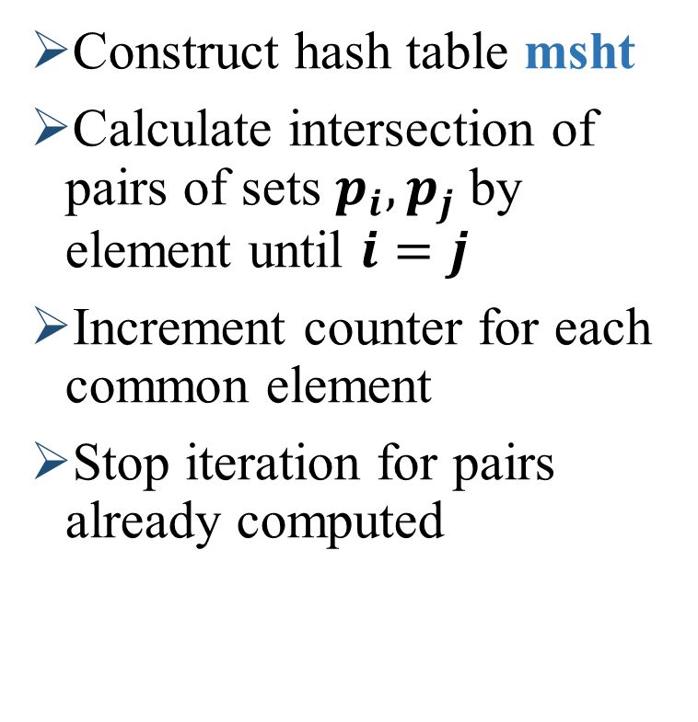
Contextual Proportionality: msJh
Construct hash table msht
Calculate intersection of pairs of sets $p_{i},p_{j}$ by element until $i=j$
Increment counter for each common element
Stop iteration for pairs already computed
Contextual Sets
p₁ | a | b | c | d
p₂ | a | d
p₃ | e | f | g
p₄ | a | b | h
p₅ | b | c | i
msht
Mh | Sets
a | p₄ | p₂ | p₁
b | p₅ | p₄ | p₁
c | p₅ | p₁
d | p₂ | p₁
e | p₃
f | p₃
g | p₃
h | p₄
i | p₅
 | p₁ | p₂ | p₃ | p₄ | p₅
p₁ | - | 2 | 0 | 2 | 2
p₂ | - | - | 0 | 1 | 0
p₃ | - | - | - | 0 | 0
p₄ | - | - | - | - | 0
p₅ | - | - | - | - | -

Slide 20
Contextual Proportionality: msJh
Construct hash table msht
Calculate intersection of pairs of sets $p_{i},p_{j}$ by element until $i=j$
Increment counter for each common element
Stop iteration for pairs already computed
Contextual Sets
p₁ | a | b | c | d
p₂ | a | d
p₃ | e | f | g
p₄ | a | b | h
p₅ | b | c | i
msht
Mh | Sets
a | p₄ | p₂ | p₁
b | p₅ | p₄ | p₁
c | p₅ | p₁
d | p₂ | p₁
e | p₃
f | p₃
g | p₃
h | p₄
i | p₅
 | p₁ | p₂ | p₃ | p₄ | p₅
p₁ | - | 2 | 0 | 2 | 2
p₂ | - | - | 0 | 1 | 0
p₃ | - | - | - | 0 | 0
p₄ | - | - | - | - | 0
p₅ | - | - | - | - | -

Slide 21
Contextual Proportionality: msJh
Construct hash table msht
Calculate intersection of pairs of sets $p_{i},p_{j}$ by element until $i=j$
Increment counter for each common element
Stop iteration for pairs already computed
Contextual Sets
p₁ | a | b | c | d
p₂ | a | d
p₃ | e | f | g
p₄ | a | b | h
p₅ | b | c | i
msht
Mh | Sets
a | p₄ | p₂ | p₁
b | p₅ | p₄ | p₁
c | p₅ | p₁
d | p₂ | p₁
e | p₃
f | p₃
g | p₃
h | p₄
i | p₅
 | p₁ | p₂ | p₃ | p₄ | p₅
p₁ | - | 2 | 0 | 2 | 2
p₂ | - | - | 0 | 1 | 0
p₃ | - | - | - | 0 | 0
p₄ | - | - | - | - | 0
p₅ | - | - | - | - | -

Slide 22
Contextual Proportionality: msJh
Construct hash table msht
Calculate intersection of pairs of sets $p_{i},p_{j}$ by element until $i=j$
Increment counter for each common element
Stop iteration for pairs already computed
Contextual Sets
p₁ | a | b | c | d
p₂ | a | d
p₃ | e | f | g
p₄ | a | b | h
p₅ | b | c | i
msht
Mh | Sets
a | p₄ | p₂ | p₁
b | p₅ | p₄ | p₁
c | p₅ | p₁
d | p₂ | p₁
e | p₃
f | p₃
g | p₃
h | p₄
i | p₅
 | p₁ | p₂ | p₃ | p₄ | p₅
p₁ | - | 2 | 0 | 2 | 2
p₂ | - | - | 0 | 1 | 0
p₃ | - | - | - | 0 | 0
p₄ | - | - | - | - | 0
p₅ | - | - | - | - | -

Slide 23
Contextual Proportionality: msJh
Construct hash table msht
Calculate intersection of pairs of sets $p_{i},p_{j}$ by element until $i=j$
Increment counter for each common element
Stop iteration for pairs already computed
Contextual Sets
p₁ | a | b | c | d
p₂ | a | d
p₃ | e | f | g
p₄ | a | b | h
p₅ | b | c | i
msht
Mh | Sets
a | p₄ | p₂ | p₁
b | p₅ | p₄ | p₁
c | p₅ | p₁
d | p₂ | p₁
e | p₃
f | p₃
g | p₃
h | p₄
i | p₅
 | p₁ | p₂ | p₃ | p₄ | p₅
p₁ | - | 2 | 0 | 2 | 2
p₂ | - | - | 0 | 1 | 0
p₃ | - | - | - | 0 | 0
p₄ | - | - | - | - | 1
p₅ | - | - | - | - | -

Slide 24
Contextual Proportionality: msJh
Construct hash table msht
Calculate intersection of pairs of sets $p_{i},p_{j}$ by element until $i=j$
Increment counter for each common element
Stop iteration for pairs already computed
Contextual Sets
p₁ | a | b | c | d
p₂ | a | d
p₃ | e | f | g
p₄ | a | b | h
p₅ | b | c | i
msht
Mh | Sets
a | p₄ | p₂ | p₁
b | p₅ | p₄ | p₁
c | p₅ | p₁
d | p₂ | p₁
e | p₃
f | p₃
g | p₃
h | p₄
i | p₅
 | p₁ | p₂ | p₃ | p₄ | p₅
p₁ | - | 2 | 0 | 2 | 2
p₂ | - | - | 0 | 1 | 0
p₃ | - | - | - | 0 | 0
p₄ | - | - | - | - | 1
p₅ | - | - | - | - | -

Slide 25
Contextual Proportionality: msJh
Construct hash table msht
Calculate intersection of pairs of sets $p_{i},p_{j}$ by element until $i=j$
Increment counter for each common element
Stop iteration for pairs already computed
Contextual Sets
p₁ | a | b | c | d
p₂ | a | d
p₃ | e | f | g
p₄ | a | b | h
p₅ | b | c | i
msht
Mh | Sets
a | p₄ | p₂ | p₁
b | p₅ | p₄ | p₁
c | p₅ | p₁
d | p₂ | p₁
e | p₃
f | p₃
g | p₃
h | p₄
i | p₅
 | p₁ | p₂ | p₃ | p₄ | p₅
p₁ | - | 2 | 0 | 2 | 2
p₂ | - | - | 0 | 1 | 0
p₃ | - | - | - | 0 | 0
p₄ | - | - | - | - | 1
p₅ | - | - | - | - | -

Slide 26
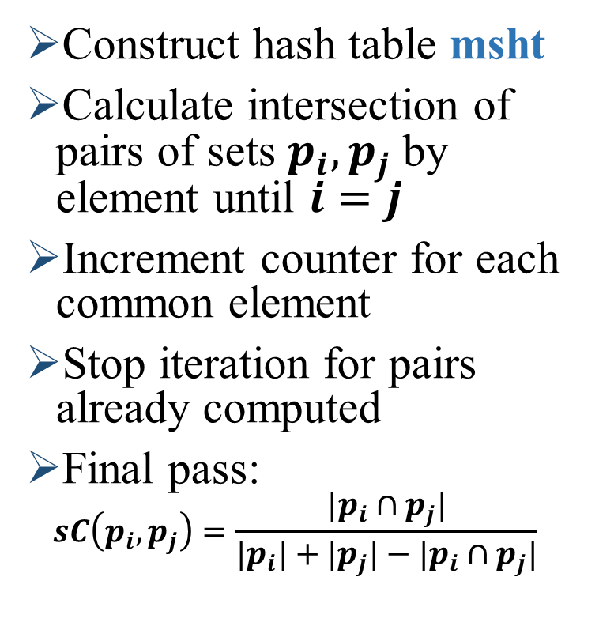
Contextual Proportionality: msJh
Construct hash table msht
Calculate intersection of pairs of sets $p_{i},p_{j}$ by element until $i=j$
Increment counter for each common element
Stop iteration for pairs already computed
Final pass:
$$sC\left(p_{i},p_{j}\right)=\frac{|p_{i}∩p_{j}|}{|p_{i}|+|p_{j}|−|p_{i}∩p_{j}|}$$
Contextual Sets
p₁ | a | b | c | d
p₂ | a | d
p₃ | e | f | g
p₄ | a | b | h
p₅ | b | c | i
msht
Mh | Sets
a | p₄ | p₂ | p₁
b | p₅ | p₄ | p₁
c | p₅ | p₁
d | p₂ | p₁
e | p₃
f | p₃
g | p₃
h | p₄
i | p₅
 | p₁ | p₂ | p₃ | p₄ | p₅
p₁ | - | 2 | 0 | 2 | 2
p₂ | - | - | 0 | 1 | 0
p₃ | - | - | - | 0 | 0
p₄ | - | - | - | - | 1
p₅ | - | - | - | - | -

Slide 27
Contextual Proportionality: msJh
Construct hash table msht
Calculate intersection of pairs of sets $p_{i},p_{j}$ by element until $i=j$
Increment counter for each common element
Stop iteration for pairs already computed
Final pass:
$$sC\left(p_{i},p_{j}\right)=\frac{|p_{i}∩p_{j}|}{|p_{i}|+|p_{j}|−|p_{i}∩p_{j}|}$$
Contextual Sets
p₁ | a | b | c | d
p₂ | a | d
p₃ | e | f | g
p₄ | a | b | h
p₅ | b | c | i
msht
Mh | Sets
a | p₄ | p₂ | p₁
b | p₅ | p₄ | p₁
c | p₅ | p₁
d | p₂ | p₁
e | p₃
f | p₃
g | p₃
h | p₄
i | p₅
 | p₁ | p₂ | p₃ | p₄ | p₅
p₁ | - | 2/4 | 0 | 2/5 | 2/5
p₂ | - | - | 0 | 1/4 | 0
p₃ | - | - | - | 0 | 0
p₄ | - | - | - | - | 1/5
p₅ | - | - | - | - | -

Slide 28

Contextual Proportionality: MsJh
Time Complexity:
  Worst case:$O(K^{2}∙|p_{i}|)$ (all sets are equal)
  Practical case: low overlap between contextual sets
Contextual Sets
p₁ | a | b | c | d
p₂ | a | d
p₃ | e | f | g
p₄ | a | b | h
p₅ | b | c | i
msht
Mh | Sets
a | p₄ | p₂ | p₁
b | p₅ | p₄ | p₁
c | p₅ | p₁
d | p₂ | p₁
e | p₃
f | p₃
g | p₃
h | p₄
i | p₅
 | p₁ | p₂ | p₃ | p₄ | p₅
p₁ | - | 2/4 | 0 | 2/5 | 2/5
p₂ | - | - | 0 | 1/4 | 0
p₃ | - | - | - | 0 | 0
p₄ | - | - | - | - | 1/5
p₅ | - | - | - | - | -

Slide 29
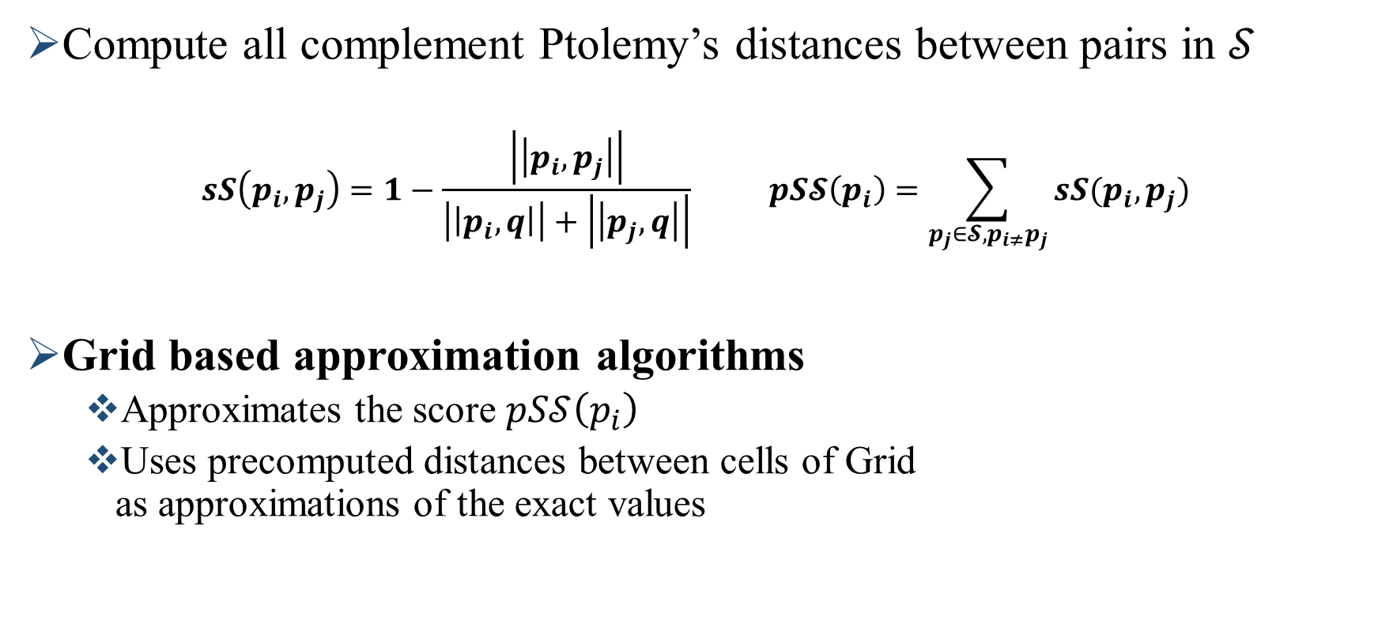
Spatial Proportionality computation
Compute all complement Ptolemy’s distances between pairs in $𝒮$
$$sS\left(p_{i},p_{j}\right)=1−\frac{\left|\left|p_{i},p_{j}\right|\right|}{\left|\left|p_{i},q\right|\right|+\left|\left|p_{j},q\right|\right|} pS𝓢\left(p_{i}\right)=\sum_{p_{j}∈𝓢,p_{i≠}p_{j}}{sS(p_{i},p_{j})}$$
Grid based approximation algorithms
  Approximates the score $pS𝒮\left(p_{i}\right)$
  Uses precomputed distances between cells of Grid
  as approximations of the exact values

Slide 30
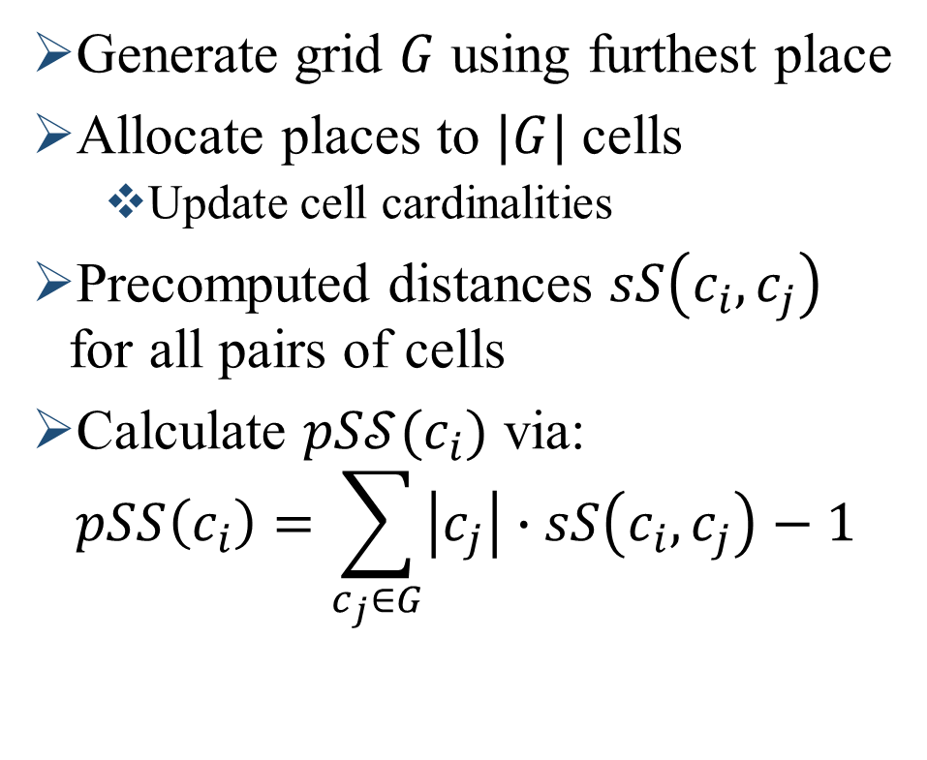
Spatial Proportionality: Grid based algorithms
Generate grid $G$ using furthest place
Allocate places to $|G|$ cells
  Update cell cardinalities
Precomputed distances $sS\left(c_{i},c_{j}\right)$ for all pairs of cells
Calculate $pS𝒮(c_{i})$ via:
$$pSS\left(c_{i}\right)=\sum_{c_{j}∈G}{\left|c_{j}\right|∙sS\left(c_{i},c_{j}\right)}−1$$

Slide 31
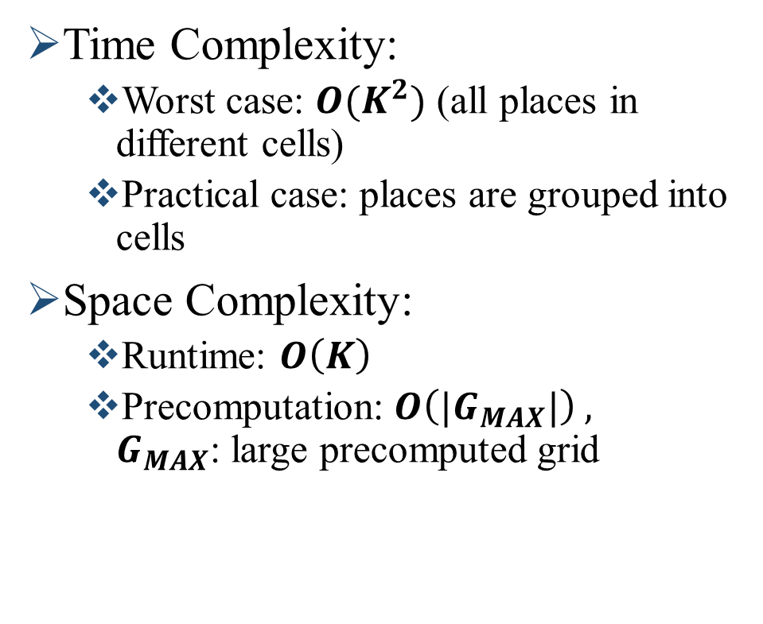
Spatial Proportionality: Grid based algorithms
Time Complexity:
  Worst case: $O(K^{2})$ (all places in different cells)
  Practical case: places are grouped into cells
Space Complexity:
  Runtime: $O\left(K\right)$
  Precomputation: $O\left({|G}_{MAX}|\right) ,$
  $G_{MAX}$: large precomputed grid

Slide 32
Spatial Proportionality: Grid based algorithms
Radial Grid variant
Higher approximation error for real world cases

Slide 33


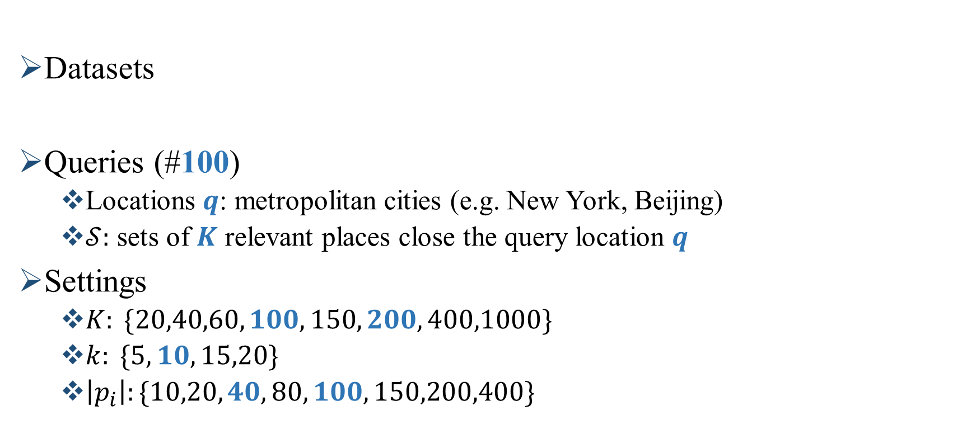
Experimental setup
Datasets
Queries (#100)
  Locations $q$: metropolitan cities (e.g. New York, Beijing)
  $𝒮:$ sets of $K$ relevant places close the query location $q$
Settings
  $K: \{20,40,60,100,150,200,400,1000\}$
  $k: \{5,10,15,20\}$
  $\left|p_{i}\right|:\{10,20,40,80,100,150,200,400\}$

Slide 34
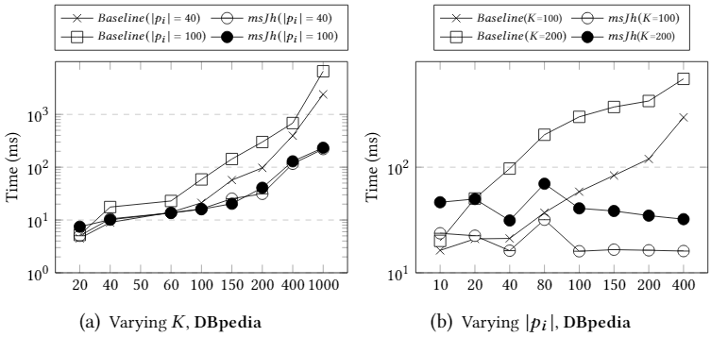

Efficiency - MsJh
Up to 1 order of magnitude more efficient.
Not significantly affected by $|p_{i}|$

Slide 35
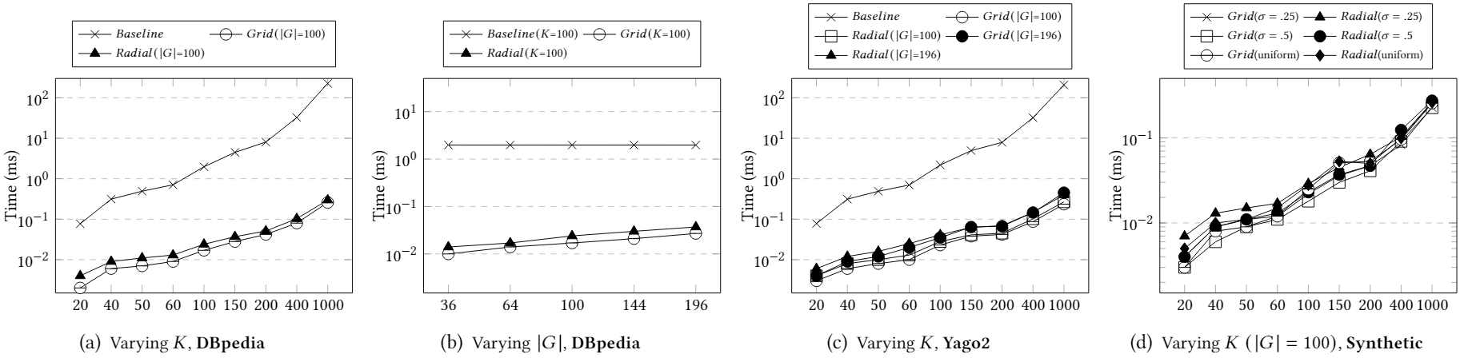
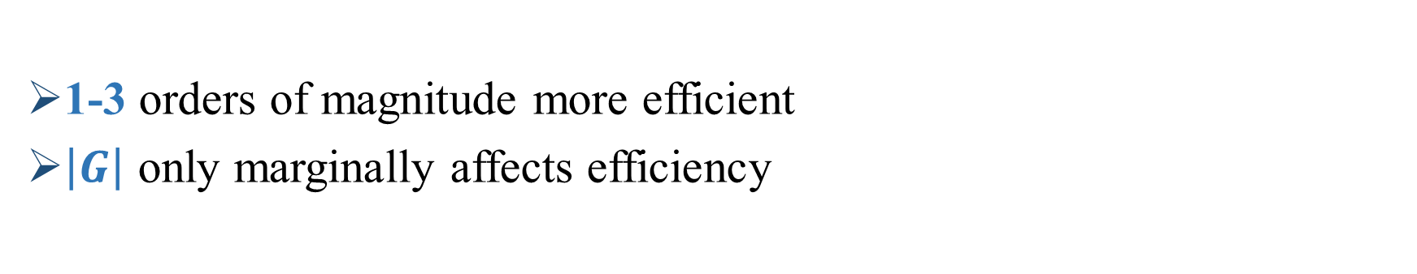
Efficiency - Grid based algorithms
1-3 orders of magnitude more efficient
$\left|G\right|$ only marginally affects efficiency

Slide 36
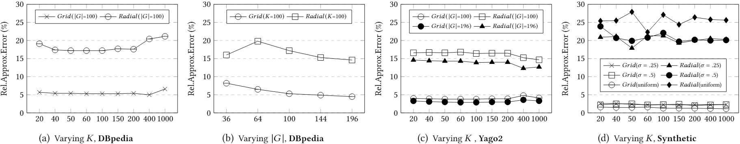
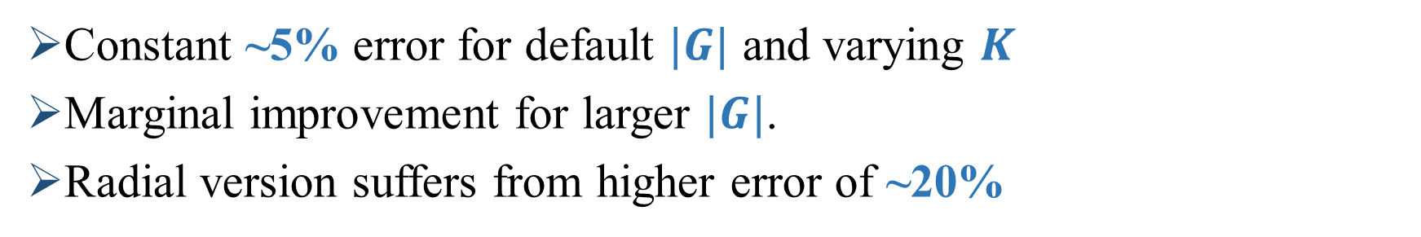
Approximation quality - Grid based algorithms
Constant ~5% error for default $|G|$ and varying $K$
Marginal improvement for larger $|G|$.
Radial version suffers from higher error of ~20%

Slide 37
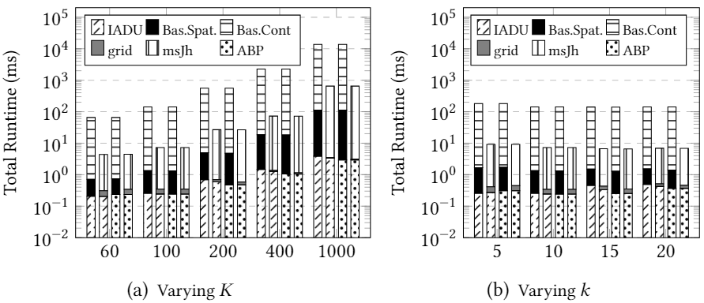
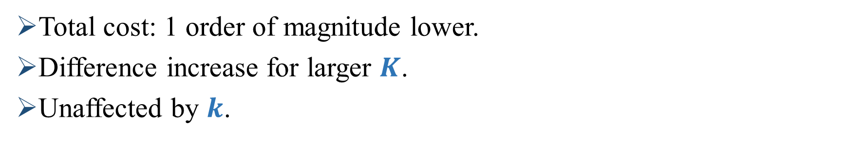
Efficiency – Proportionality Framework
Total cost: 1 order of magnitude lower.
Difference increase for larger $K$.
Unaffected by $k$.

Slide 38
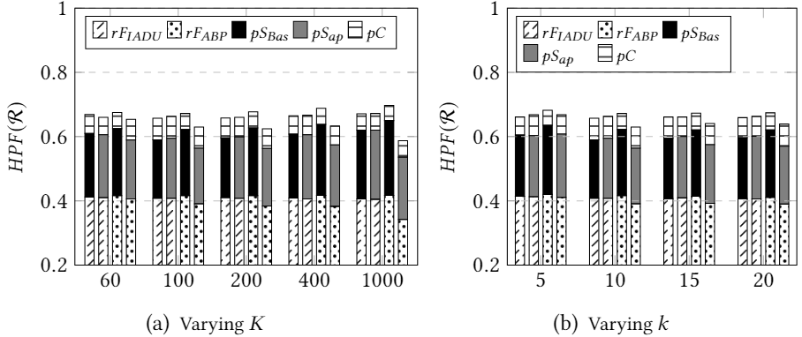

Approximation quality– Prop. Framework
ABP achieves marginally higher $HPF(ℛ)$ score.
Minor approximation compromise due to the Grid algorithm.

Slide 39
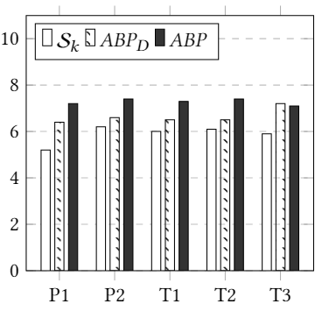
User evaluation
10 evaluators
Asked to evaluated on 1-10 scale
  Overall result (P1)
  Ranking (P2)
  3 Usability tasks (T1-T3)
Clear preference for proportional results for P1,P2 – T1,T2

Slide 40
Summary
We have
  introduced the problem of proportionality in location based retrieval for places with context.
  proposed a generic algorithmic framework that adapts existing greedy diversification algorithms.
  proposed a novel efficient algorithm for contextual proportionality (MsJh).
  proposed a novel efficient algorithm for the calculation of spatial proportionality (Grid based algorithm).
  presented a thorough evaluation on real datasets.

Slide 41
Thank you
georgios.kalamatianos@it.uu.se

Slide 42
Contextual Proportionality: MsJh (backup)
 | p₁ | p₂ | p₃ | p₄ | p₅
p₁:{a,b,c,d}
p₂ :{a,d}
p₃:{e,f,g}
p₄:{a,b,h}
p₅:{b,c,i}
Mh | Sets
a | p₄ | p₂ | p₁
b | p₅ | p₄ | p₁
c | p₅ | p₁
d | p₂ | p₁
e | p₃
f | p₃
g | p₃
h | p₄
i | p₅

Slide 43
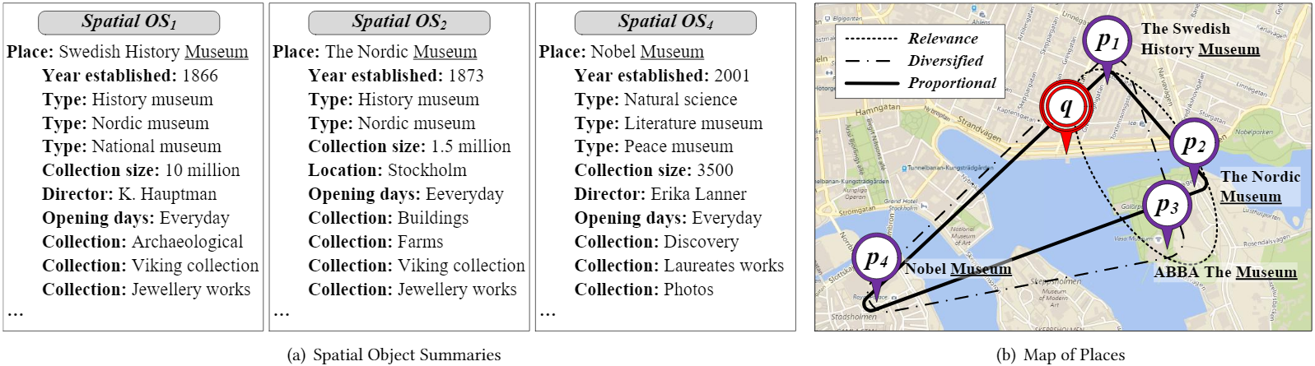
Example of top-3 retrieval
Example: A query Q: {q, museum}
  A relevance query result could include p₁, p₂ and p₃.
  A diversified query result could include p₁, p₃ and p₄.
  A proportional query result could include p₁, p₂ and p₄.

Slide 45
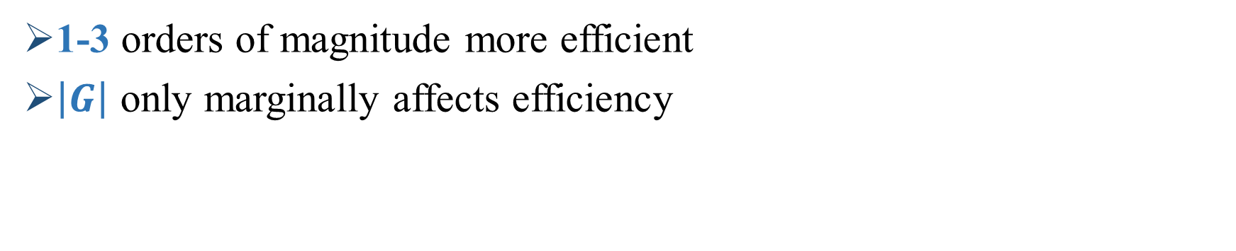
Efficiency - Grid based algorithms
1-3 orders of magnitude more efficient
$\left|G\right|$ only marginally affects efficiency

Slide 46
Spatial Proportionality: Grid based algorithms (backup

Slide 47
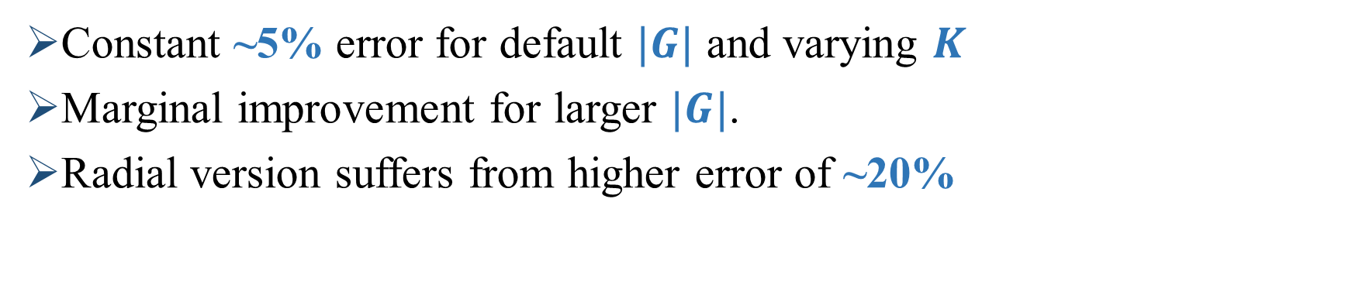
Approximation quality - Grid based algorithms
Constant ~5% error for default $|G|$ and varying $K$
Marginal improvement for larger $|G|$.
Radial version suffers from higher error of ~20%

Slide 48
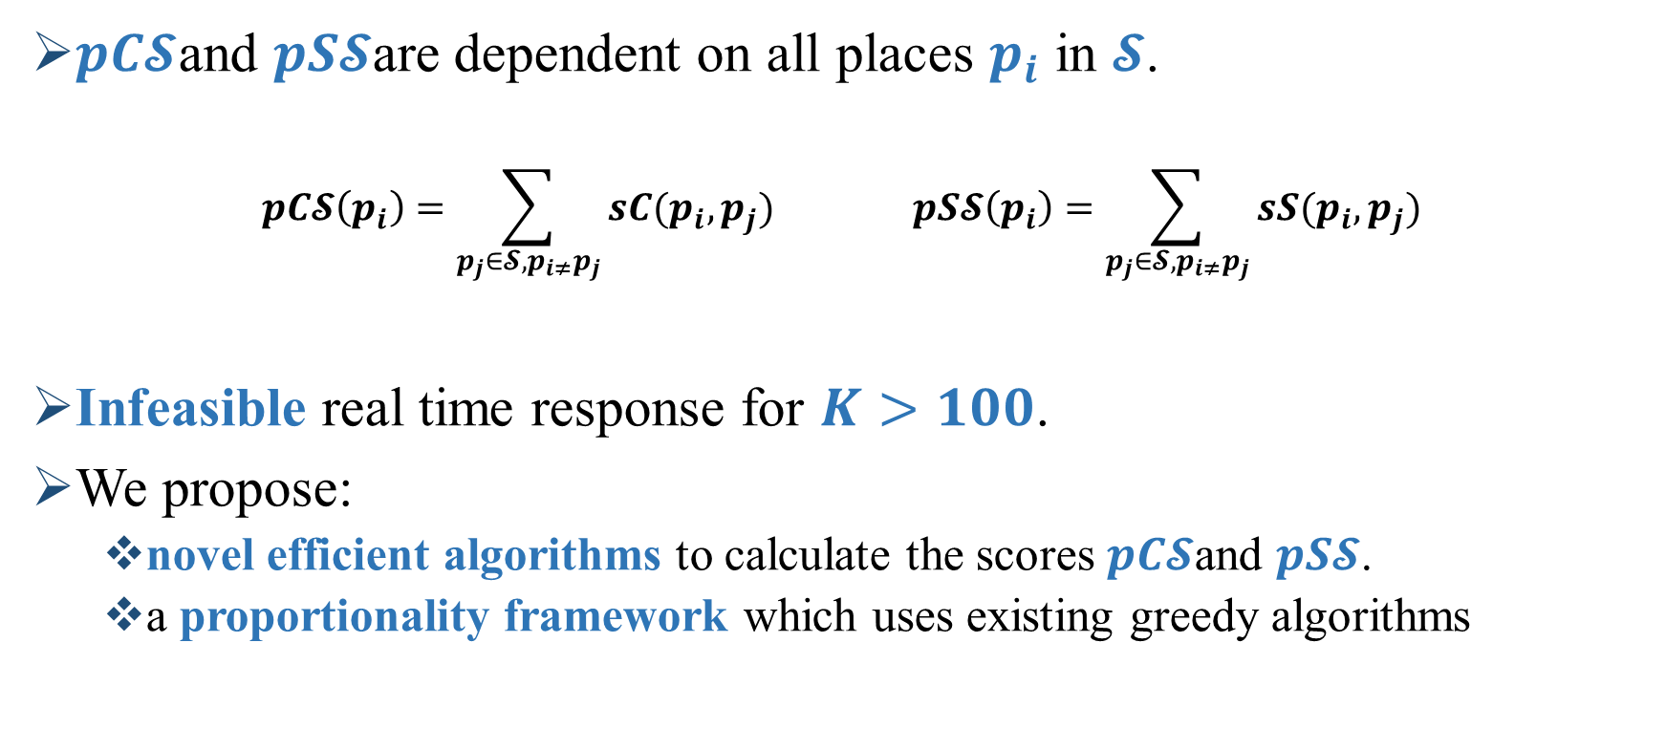
kPSP
$pC𝓢$and $pS𝓢$are dependent on all places $p_{i}$ in $𝓢$.
$$pC𝓢\left(p_{i}\right)=\sum_{p_{j}∈𝓢,p_{i≠}p_{j}}{sC(p_{i},p_{j})} pS𝓢\left(p_{i}\right)=\sum_{p_{j}∈𝓢,p_{i≠}p_{j}}{sS(p_{i},p_{j})}$$
Infeasible real time response for $K>100$.
We propose:
  novel efficient algorithms to calculate the scores $pC𝓢$and $pS𝓢$.
  a proportionality framework which uses existing greedy algorithms

Slide 49
Computational Challenges
Proportionality depends on the similarity between all candidate places
Large number of places
Expensive calculations for real time responses
We propose novel efficient algorithms for the calculation of spatial and contextual proportionality

