Slide 1
Diversified spatial keyword search on RDF data
Georgios Kalamatianos
PhD Student
georgios.kalamatianos@it.uu.se

Slide 2
Outline
Motivation
Background
kDSP Problem
Greedy Algorithms
Experimental Evaluation
Conclusion

Slide 3
Motivation Datasets are everywhere
Datasets, Databases and data-graphs are everywhere:
Web, Desktops, etc.
Semantic knowledge graphs, e.g. Dbpedia, YAGO
Spatial Data
Acknowledging the significance of discovering datasets
Google introduced Google Dataset Search, (discovering of web-accessible datasets)
Difficult to retrieve information unless users are familiar with:
the data schema
query languages (e.g. SPARQL, GeoSPARQL)
Solutions like Keyword search can liberate users from such technicalities.

Slide 4
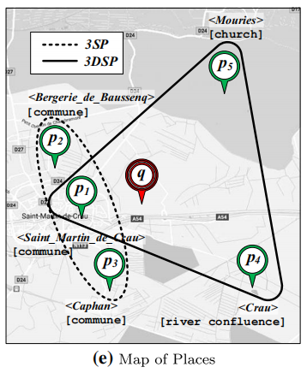
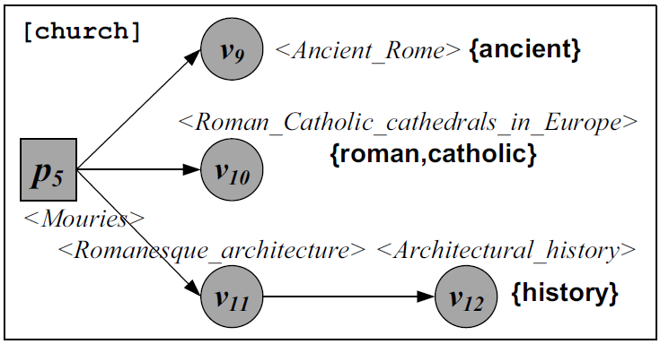
Motivation Location based keyword search
Given datasets with nodes representing places
We study the retrieval of data using a query Q with:
Keywords (e.g. {ancient, roman, ..})
Location q (latitude, longitude)

Slide 5
Outline
Motivation
Background
kDSP Problem
Greedy Algorithms
Experimental Evaluation
Conclusion

Slide 6
Background RDF: Resource Description Framework
Format: <subject, predicate, object>
Transforms into a knowledge graph
Subject/object > Nodes
Predicate > Edge
Notes:
Add figure

Slide 7
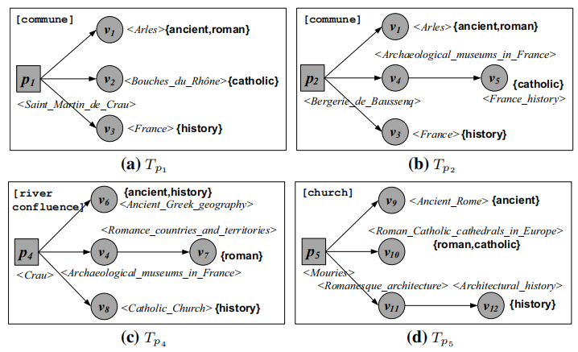
Background Retrieval on Spatial RDF data
Query: {q , {ancient, roman, catholic, history}}
A top-k semantic place (kSP) query result could include p₁, p₂ and p₃.
[Shi, Wu, Mamoulis, SIGMOD, 2016]

Slide 8
Background Retrieval on Spatial RDF data
Qualifying Tree
Consists of nodes which contain all of the query’s keywords
Rooted at a node representing a place
Keywords: {ancient, roman, catholic, history}
[Shi, Wu, Mamoulis, SIGMOD, 2016]

Slide 9
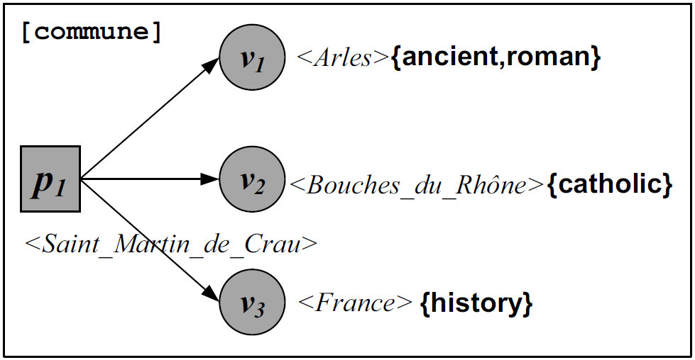
Background Retrieval on Spatial RDF data
Relevance Scores of Places (Trees)
Distance: spatial distance between place and query location
Looseness: Measure of relevance.
Low: Keywords occur close to the root of the tree
High: Keywords occur further from the root of the tree
Keywords: {ancient, roman, catholic, history}
[Shi, Wu, Mamoulis, SIGMOD, 2016]

Slide 10
Background Retrieval on Spatial RDF data
Query: {q , {ancient, roman, catholic, history} }
A top-k semantic place (kSP) query result: p₁, p₂ and p₃.
A diversified kSP result: p₁, p₄ and p₅.
Where places are in all directions and their contents are diverse

Slide 11
Outline
Motivation
Background
kDSP Problem
Greedy Algorithms
Experimental Evaluation
Conclusion

Slide 12
Objectives Diversified keyword search on spatial data
Results based entirely on relevance may have similar content and location
Users prefer diverse results
We propose a trade-off between relevance and diversity
k-Diverse Semantic Places (kDSP) problem
Propose efficient and effective approximation algorithms to solve the kDSP problem

Slide 13
kDSP Problem Definition Relevance function
Looseness based relevance score:
Spatial distance score:
Holistic relevance score:
f(p) calculation is orthogonal to this work and thus is calculated by kSP algorithms (BSP,SPP)
[Shi, Wu, Mamoulis, SIGMOD, 2016]

Slide 14
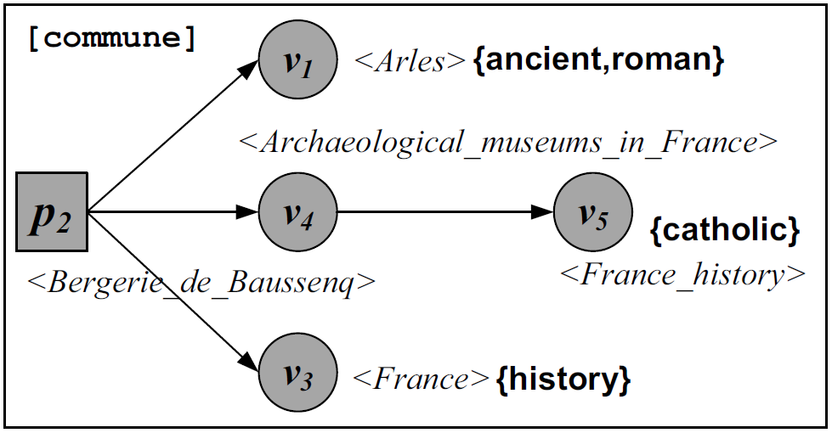
kDSP Problem Definition Diversity function
1. Jaccard Distance dL(T_{p}, T_{p'})
Ranges [0,1]
$dL\left(T_{p_{1}},T_{p_{2}}\right)=\frac{7−2}{7}$=0.71
2. Ptolemy’s Spatial diversity $dS\left(p,p^{′}\right)=\frac{||p,p′||}{||p,q||+||p^{′},q||}$
Notes:
Say range (0,1) add numbers to equations

Slide 15
kDSP Problem Definition Diversity function
1. Jaccard Distance dL(T_{p}, T_{p'})
Ranges [0,1]
$dL\left(T_{p_{1}},T_{p_{2}}\right)=\frac{7−2}{7}$=0.71
2. Ptolemy’s Spatial diversity $dS\left(p,p^{′}\right)=\frac{||p,p′||}{||p,q||+||p^{′},q||}$
Notes:
Say range (0,1) add numbers to equations

Slide 16
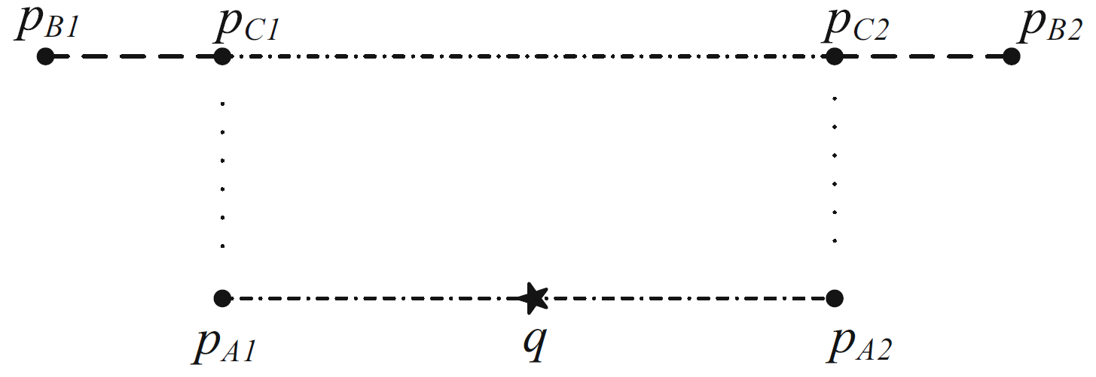
kDSP Problem Definition Ptolemy’s Spatial diversity
Ptolemy’s Spatial diversity $dS\left(p,p^{′}\right)=\frac{||p,p′||}{||p,q||+||p^{′},q||}$
dS(p_{A1} , p_{A2})=1 > dS(p_{B1} , p_{B2}) = 0.8 > dS(p_{C1} , p_{C2}) = 0.7
Ranges [0,1]

Slide 17
kDSP Problem Definition Ptolemy’s Spatial diversity
Ptolemy’s Spatial diversity $dS\left(p,p^{′}\right)=\frac{||p,p′||}{||p,q||+||p^{′},q||}$
p_{D1}
p_{D2}
$$∞$$
$$∞$$
dS(p_{D1} , p_{D2})$→0$

Slide 18
kDSP Problem Definition Diversity function
1. Ptolemy’s Spatial diversity $dS\left(p,p^{′}\right)$
2. Jaccard Distance dL(T_{p}, T_{p'})
3. Diversity between p and p' (where γ controls the contribution of the two diversification components.):
4. Holistic score of place p combines relevance and diversity, where λ adjusts their trade-off:
Notes:
Say range (0,1) add numbers to equations

Slide 19
kDSP Problem Definition
Given a query Q with a location q, a set of keywords and an integer k, the kDSP query returns a set R of k place entities that have the highest HDf(R) score, where:
HDf (p) compares with k −1 places of a candidate R set, we have to consider all O(n^{k}) candidate R sets.
Thus, we propose two greedy algorithms

Slide 20
Outline
Motivation
Background
kDSP Problem
Greedy Algorithms
Experimental Evaluation
Conclusion

Slide 21
Incremental Addition and Update IAdU Algorithm
Process candidate places in descending order of relevance score
Iteratively constructs the result set R
We select the place that will have maximal contribution to the score HDF(R)
We update cHDf(p) of unselected places when a place is added in R
Uses a bound, θ, to prune fruitless places

Slide 22
Incremental Addition and Update IAdU Algorithm
curP
→ | p₆ , 0.9
 | p₃ , 0.8
 | p₂ , 0.6
 | p₁ , 0.5
 | p₄ , 0.4
 | p₅ , 0.3
 | p₇ , 0.1
H (p_{i} , cHDF_{i})
Process candidate places in descending order of relevance score
Iteratively constructs the result set R
We select the place that will have maximal contribution to the score HDF(R)
We update cHDf(p) of unselected places when a place is added in R
Uses a bound, θ, to prune fruitless places
R | θ = | ∞
Notes:
Add hdf function here? Highlight

Slide 23
Incremental Addition and Update IAdU Algorithm
curP
 | p₆ , 0.9
→ | p₃ , 0.8
 | p₂ , 0.6
 | p₁ , 0.5
 | p₄ , 0.4
 | p₅ , 0.3
 | p₇ , 0.1
H (p_{i} , cHDF_{i})
(p₃ , 3.31)
Process candidate places in descending order of relevance score
Iteratively constructs the result set R
We select the place that will have maximal contribution to the score HDF(R)
We update cHDf(p) of unselected places when a place is added in R
Uses a bound, θ, to prune fruitless places
R | θ = | ∞
p₆

Slide 24
Incremental Addition and Update IAdU Algorithm
curP
 | p₆ , 0.9
→ | p₃ , 0.8
 | p₂ , 0.6
 | p₁ , 0.5
 | p₄ , 0.4
 | p₅ , 0.3
 | p₇ , 0.1
H (p_{i} , cHDF_{i})
(p₃ , 3.31)
Process candidate places in descending order of relevance score
Iteratively constructs the result set R
We select the place that will have maximal contribution to the score HDF(R)
We update cHDf(p) of unselected places when a place is added in R
Uses a bound, θ, to prune fruitless places
R | θ = | 3.7
p₆

Slide 25
Incremental Addition and Update IAdU Algorithm
curP
 | p₆ , 0.9
 | p₃ , 0.8
→ | p₂ , 0.6
 | p₁ , 0.5
 | p₄ , 0.4
 | p₅ , 0.3
 | p₇ , 0.1
H (p_{i} , cHDF_{i})
(p₃ , 3.31)
(p₂ , 2.8)
Process candidate places in descending order of relevance score
Iteratively constructs the result set R
We select the place that will have maximal contribution to the score HDF(R)
We update cHDf(p) of unselected places when a place is added in R
Uses a bound, θ, to prune fruitless places
R | θ = | 3.5
p₆

Slide 26
Incremental Addition and Update IAdU Algorithm
curP
 | p₆ , 0.9
 | p₃ , 0.8
 | p₂ , 0.6
→ | p₁ , 0.5
 | p₄ , 0.4
 | p₅ , 0.3
 | p₇ , 0.1
H (p_{i} , cHDF_{i})
(p₃ , 3.31)
(p₁ , 3.19)
(p₂ , 2.8)
Process candidate places in descending order of relevance score
Iteratively constructs the result set R
We select the place that will have maximal contribution to the score HDF(R)
We update cHDf(p) of unselected places when a place is added in R
Uses a bound, θ, to prune fruitless places
R | θ = | 3.4
p₆

Slide 27
Incremental Addition and Update IAdU Algorithm
curP
 | p₆ , 0.9
 | p₃ , 0.8
 | p₂ , 0.6
 | p₁ , 0.5
→ | p₄ , 0.4
 | p₅ , 0.3
 | p₇ , 0.1
H (p_{i} , cHDF_{i})
(p₃ , 3.31)
(p₄ , 3.22)
(p₁ , 3.19)
(p₂ , 2.8)
Process candidate places in descending order of relevance score
Iteratively constructs the result set R
We select the place that will have maximal contribution to the score HDF(R)
We update cHDf(p) of unselected places when a place is added in R
Uses a bound, θ, to prune fruitless places
R | θ = | 3.3
p₆

Slide 28
Incremental Addition and Update IAdU Algorithm
curP
 | p₆ , 0.9
 | p₃ , 0.8
 | p₂ , 0.6
 | p₁ , 0.5
→ | p₄ , 0.4
 | p₅ , 0.3
 | p₇ , 0.1
H (p_{i} , cHDF_{i})
(p₃ , 3.31)
(p₄ , 3.22)
(p₁ , 3.19)
(p₂ , 2.8)
Process candidate places in descending order of relevance score
Iteratively constructs the result set R
We select the place that will have maximal contribution to the score HDF(R)
We update cHDf(p) of unselected places when a place is added in R
Uses a bound, θ, to prune fruitless places
R | θ = | 3.3
p₆
p₃

Slide 29
Incremental Addition and Update IAdU Algorithm
curP
 | p₆ , 0.9
 | p₃ , 0.8
 | p₂ , 0.6
 | p₁ , 0.5
→ | p₄ , 0.4
 | p₅ , 0.3
 | p₇ , 0.1
H (p_{i} , cHDF_{i})
(p₁ , 6.4)
(p₄ , 6.02)
(p₂ , 5.5)
Process candidate places in descending order of relevance score
Iteratively constructs the result set R
We select the place that will have maximal contribution to the score HDF(R)
We update cHDf(p) of unselected places when a place is added in R
Uses a bound, θ, to prune fruitless places
R | θ = | 6.3
p₆
p₃

Slide 30
Incremental Addition and Update IAdU Algorithm
curP
 | p₆ , 0.9
 | p₃ , 0.8
 | p₂ , 0.6
 | p₁ , 0.5
→ | p₄ , 0.4
 | p₅ , 0.3
 | p₇ , 0.1
H (p_{i} , cHDF_{i})
(p₁ , 6.4)
(p₄ , 6.02)
(p₂ , 5.5)
Process candidate places in descending order of relevance score
Iteratively constructs the result set R
We select the place that will have maximal contribution to the score HDF(R)
We update cHDf(p) of unselected places when a place is added in R
Uses a bound, θ, to prune fruitless places
R | θ = | 6.3
p₆
p₃
p₁

Slide 31
Incremental Addition and Update IAdU Algorithm
curP
 | p₆ , 0.9
 | p₃ , 0.8
 | p₂ , 0.6
 | p₁ , 0.5
 | p₄ , 0.4
→ | p₅ , 0.3
 | p₇ , 0.1
H (p_{i} , cHDF_{i})
(p₅ , 6.31)
(p₄ , 6.02)
(p₂ , 5.5)
Process candidate places in descending order of relevance score
Iteratively constructs the result set R
We select the place that will have maximal contribution to the score HDF(R)
We update cHDf(p) of unselected places when a place is added in R
Uses a bound, θ, to prune fruitless places
R | θ = | 6.5
p₆
p₃
p₁

Slide 32
Incremental Addition and Update IAdU Algorithm
curP
 | p₆ , 0.9
 | p₃ , 0.8
 | p₂ , 0.6
 | p₁ , 0.5
 | p₄ , 0.4
 | p₅ , 0.3
→ | p₇ , 0.1
H (p_{i} , cHDF_{i})
(p₂ , 8.71)
(p₅ , 7.31)
(p₄ , 7.02)
(p₇ , 6.5)
Process candidate places in descending order of relevance score
Iteratively constructs the result set R
We select the place that will have maximal contribution to the score HDF(R)
We update cHDf(p) of unselected places when a place is added in R
Uses a bound, θ, to prune fruitless places
R | θ = | 6.5
p₆
p₃
p₁

Slide 33
Incremental Addition and Update IAdU Algorithm
curP
 | p₆ , 0.9
 | p₃ , 0.8
 | p₂ , 0.6
 | p₁ , 0.5
 | p₄ , 0.4
 | p₅ , 0.3
→ | p₇ , 0.1
H (p_{i} , cHDF_{i})
(p₂ , 8.71)
(p₅ , 7.31)
(p₄ , 7.02)
(p₇ , 6.5)
Processes candidate places in descending order of relevance score
Iteratively constructs the result set R
We select the place that will have maximal contribution to the score HDF(R)
We update cHDf(p) of unselected places when a place is added in R
Uses a bound, θ, to prune fruitless places
R | θ = | 6.5
p₆
p₃
p₁
p₂

Slide 34
Add Best Pairs ABP Algorithm
Processes candidate places in descending order of relevance score f(p)
Iteratively constructs the result set R
Select the pairs of places with maximal pairwise score HDf(p,p’)
Uses a bound, θ, to prune fruitless pairs
Does not consider places already in R
Maintains:
A ranked list F_{list}
A max heap PairsH[p] for each p in F_{list}
A max heap maxPairH containing the max elements of PairsH[p]

Slide 35
Add Best Pairs ABP Algorithm
F_{List} |  | PairsH
→ | p₆ , 0.9
maxPairH
Processes candidate places in descending order of relevance score f(p)
Iteratively constructs the result set R
Select the pairs of places with maximal pairwise score HDf(p,p’)
Uses a bound, θ, to prune fruitless pairs
Does not consider places already in R
R | θ = | ∞

Slide 36
Add Best Pairs ABP Algorithm
F_{List} |  | PairsH
 | p₆ , 0.9
→ | p₃ , 0.8 | (p₃ , p₆ , 3.31)
maxPairH
Processes candidate places in descending order of relevance score f(p)
Iteratively constructs the result set R
Select the pairs of places with maximal pairwise score HDf(p,p’)
Uses a bound, θ, to prune fruitless pairs
Does not consider places already in R
R | θ = | ∞

Slide 37
Add Best Pairs ABP Algorithm
F_{List} |  | PairsH
 | p₆ , 0.9
→ | p₃ , 0.8 | (p₃ , p₆ , 3.31)
maxPairH
(p₃ , p₆ , 3.31)
Processes candidate places in descending order of relevance score f(p)
Iteratively constructs the result set R
Select the pairs of places with maximal pairwise score HDf(p,p’)
Uses a bound, θ, to prune fruitless pairs
Does not consider places already in R
R | θ = | 3.7

Slide 38
Add Best Pairs ABP Algorithm
F_{List} |  | PairsH
 | p₆ , 0.9
 | p₃ , 0.8 | (p₃ , p₆ , 3.31)
→ | p₂ , 0.6
maxPairH
(p₃ , p₆ , 3.31)
Processes candidate places in descending order of relevance score f(p)
Iteratively constructs the result set R
Select the pairs of places with maximal pairwise score HDf(p,p’)
Uses a bound, θ, to prune fruitless pairs
Does not consider places already in R
R | θ = | 3.7

Slide 39
Add Best Pairs ABP Algorithm
F_{List} |  | PairsH
 | p₆ , 0.9
 | p₃ , 0.8 | (p₃ , p₆ , 3.31)
→ | p₂ , 0.6 | (p₂ , p₆ , 2.8) (p₂ , p₃ , 2.7)
maxPairH
(p₃ , p₆ , 3.31)
Processes candidate places in descending order of relevance score f(p)
Iteratively constructs the result set R
Select the pairs of places with maximal pairwise score HDf(p,p’)
Uses a bound, θ, to prune fruitless pairs
Does not consider places already in R
R | θ = | 3.7

Slide 40
Add Best Pairs ABP Algorithm
F_{List} |  | PairsH
 | p₆ , 0.9
 | p₃ , 0.8 | (p₃ , p₆ , 3.31)
→ | p₂ , 0.6 | (p₂ , p₆ , 2.8) (p₂ , p₃ , 2.7)
maxPairH
(p₃ , p₆ , 3.31)
(p₂ , p₆ , 2.8)
Processes candidate places in descending order of relevance score f(p)
Iteratively constructs the result set R
Select the pairs of places with maximal pairwise score HDf(p,p’)
Uses a bound, θ, to prune fruitless pairs
Does not consider places already in R
R | θ = | 3.5

Slide 41
Add Best Pairs ABP Algorithm
F_{List} |  | PairsH
 | p₆ , 0.9
 | p₃ , 0.8 | (p₃ , p₆ , 3.31)
 | p₂ , 0.6 | (p₂ , p₆ , 2.8) (p₂ , p₃ , 2.7)
→ | p₁ , 0.5
maxPairH
(p₃ , p₆ , 3.31)
(p₂ , p₆ , 2.8)
Processes candidate places in descending order of relevance score f(p)
Iteratively constructs the result set R
Select the pairs of places with maximal pairwise score HDf(p,p’)
Uses a bound, θ, to prune fruitless pairs
Does not consider places already in R
R | θ = | 3.5

Slide 42
Add Best Pairs ABP Algorithm
F_{List} |  | PairsH
 | p₆ , 0.9
 | p₃ , 0.8 | (p₃ , p₆ , 3.31)
 | p₂ , 0.6 | (p₂ , p₆ , 2.8) (p₂ , p₃ , 2.7)
→ | p₁ , 0.5 | (p₁ , p₃ , 3.21) (p₁ , p₂ , 3.21) (p₁ , p₆ , 3.19)
maxPairH
(p₃ , p₆ , 3.31)
(p₂ , p₆ , 2.8)
Processes candidate places in descending order of relevance score f(p)
Iteratively constructs the result set R
Select the pairs of places with maximal pairwise score HDf(p,p’)
Uses a bound, θ, to prune fruitless pairs
Does not consider places already in R
R | θ = | 3.5

Slide 43
Add Best Pairs ABP Algorithm
F_{List} |  | PairsH
 | p₆ , 0.9
 | p₃ , 0.8 | (p₃ , p₆ , 3.31)
 | p₂ , 0.6 | (p₂ , p₆ , 2.8) (p₂ , p₃ , 2.7)
→ | p₁ , 0.5 | (p₁ , p₃ , 3.21) (p₁ , p₂ , 3.21) (p₁ , p₆ , 3.19)
maxPairH
(p₃ , p₆ , 3.31)
(p₂ , p₆ , 2.8)
(p₁ , p₃ , 3.21)
Processes candidate places in descending order of relevance score f(p)
Iteratively constructs the result set R
Select the pairs of places with maximal pairwise score HDf(p,p’)
Uses a bound, θ, to prune fruitless pairs
Does not consider places already in R
R | θ = | 3.4

Slide 44
Add Best Pairs ABP Algorithm
F_{List} |  | PairsH
 | p₆ , 0.9
 | p₃ , 0.8 | (p₃ , p₆ , 3.31)
 | p₂ , 0.6 | (p₂ , p₆ , 2.8) (p₂ , p₃ , 2.7)
 | p₁ , 0.5 | (p₁ , p₃ , 3.21) (p₁ , p₂ , 3.21) (p₁ , p₆ , 3.19)
→ | p₄ , 0.4
maxPairH
(p₃ , p₆ , 3.31)
(p₂ , p₆ , 2.8)
(p₁ , p₃ , 3.21)
Processes candidate places in descending order of relevance score f(p)
Iteratively constructs the result set R
Select the pairs of places with maximal pairwise score HDf(p,p’)
Uses a bound, θ, to prune fruitless pairs
Does not consider places already in R
R | θ = | 3.4

Slide 45
Add Best Pairs ABP Algorithm
F_{List} |  | PairsH
 | p₆ , 0.9
 | p₃ , 0.8 | (p₃ , p₆ , 3.31)
 | p₂ , 0.6 | (p₂ , p₆ , 2.8) (p₂ , p₃ , 2.7)
 | p₁ , 0.5 | (p₁ , p₃ , 3.21) (p₁ , p₂ , 3.21) (p₁ , p₆ , 3.19)
→ | p₄ , 0.4 | (p₄ , p₆ , 3.22) (p₄ , p₃ , 2.8) (p₄ , p₂ , 1.2) (p₄ , p₁ , 1)
maxPairH
(p₃ , p₆ , 3.31)
(p₂ , p₆ , 2.8)
(p₁ , p₃ , 3.21)
Processes candidate places in descending order of relevance score f(p)
Iteratively constructs the result set R
Select the pairs of places with maximal pairwise score HDf(p,p’)
Uses a bound, θ, to prune fruitless pairs
Does not consider places already in R
R | θ = | 3.4

Slide 46
Add Best Pairs ABP Algorithm
F_{List} |  | PairsH
 | p₆ , 0.9
 | p₃ , 0.8 | (p₃ , p₆ , 3.31)
 | p₂ , 0.6 | (p₂ , p₆ , 2.8) (p₂ , p₃ , 2.7)
 | p₁ , 0.5 | (p₁ , p₃ , 3.21) (p₁ , p₂ , 3.21) (p₁ , p₆ , 3.19)
→ | p₄ , 0.4 | (p₄ , p₆ , 3.22) (p₄ , p₃ , 2.8) (p₄ , p₂ , 1.2) (p₄ , p₁ , 1)
maxPairH
(p₃ , p₆ , 3.31)
(p₂ , p₆ , 2.8)
(p₁ , p₃ , 3.21)
(p₄ , p₆ , 3.22)
Processes candidate places in descending order of relevance score f(p)
Iteratively constructs the result set R
Select the pairs of places with maximal pairwise score HDf(p,p’)
Uses a bound, θ, to prune fruitless pairs
Does not consider places already in R
R | θ = | 3.3

Slide 47
Add Best Pairs ABP Algorithm
F_{List} |  | PairsH
 | p₆ , 0.9
 | p₃ , 0.8 | (p₃ , p₆ , 3.31)
 | p₂ , 0.6 | (p₂ , p₆ , 2.8) (p₂ , p₃ , 2.7)
 | p₁ , 0.5 | (p₁ , p₃ , 3.21) (p₁ , p₂ , 3.21) (p₁ , p₆ , 3.19)
→ | p₄ , 0.4 | (p₄ , p₆ , 3.22) (p₄ , p₃ , 2.8) (p₄ , p₂ , 1.2) (p₄ , p₁ , 1)
maxPairH
(p₃ , p₆ , 3.31)
(p₂ , p₆ , 2.8)
(p₁ , p₃ , 3.21)
(p₄ , p₆ , 3.22)
Processes candidate places in descending order of relevance score f(p)
Iteratively constructs the result set R
Select the pairs of places with maximal pairwise score HDf(p,p’)
Uses a bound, θ, to prune fruitless pairs
Does not consider places already in R
R | θ = | 3.3
p₃
p₆

Slide 48
Add Best Pairs ABP Algorithm
F_{List} |  | PairsH
 | p₆ , 0.9
 | p₃ , 0.8 | (p₃ , p₆ , 3.31)
 | p₂ , 0.6 | (p₂ , p₆ , 2.8) (p₂ , p₃ , 2.7)
 | p₁ , 0.5 | (p₁ , p₃ , 3.21) (p₁ , p₂ , 3.21) (p₁ , p₆ , 3.19)
→ | p₄ , 0.4 | (p₄ , p₆ , 3.22) (p₄ , p₃ , 2.8) (p₄ , p₂ , 1.2) (p₄ , p₁ , 1)
maxPairH
(p₃ , p₆ , 3.31)
(p₂ , p₆ , 2.8)
(p₁ , p₃ , 3.21)
(p₄ , p₆ , 3.22)
Processes candidate places in descending order of relevance score f(p)
Iteratively constructs the result set R
Select the pairs of places with maximal pairwise score HDf(p,p’)
Uses a bound, θ, to prune fruitless pairs
Does not consider places already in R
R | θ = | 3.3
p₃
p₆

Slide 49
Add Best Pairs ABP Algorithm
F_{List} |  | PairsH
 | p₂ , 0.6 | (p₂ , p₃ , 2.7)
 | p₁ , 0.5 | (p₁ , p₂ , 3.21) (p₁ , p₆ , 3.19)
→ | p₄ , 0.4 | (p₄ , p₃ , 2.8) (p₄ , p₂ , 1.2) (p₄ , p₁ , 1)
maxPairH
(p₂ , p₆ , 2.8)
(p₁ , p₃ , 3.21)
(p₄ , p₆ , 3.22)
Processes candidate places in descending order of relevance score f(p)
Iteratively constructs the result set R
Select the pairs of places with maximal pairwise score HDf(p,p’)
Uses a bound, θ, to prune fruitless pairs
Does not consider places already in R
R | θ = | 3.3
p₃
p₆

Slide 50
Add Best Pairs ABP Algorithm
F_{List} |  | PairsH
 | p₂ , 0.6 | (p₂ , p₃ , 2.7)
 | p₁ , 0.5 | (p₁ , p₂ , 3.21) (p₁ , p₆ , 3.19)
→ | p₄ , 0.4 | (p₄ , p₃ , 2.8) (p₄ , p₂ , 1.2) (p₄ , p₁ , 1)
maxPairH
(p₂ , p₆ , 2.8)
(p₁ , p₃ , 3.21)
(p₄ , p₆ , 3.22)
(p₁ , p₂ , 3.21)
Processes candidate places in descending order of relevance score f(p)
Iteratively constructs the result set R
Select the pairs of places with maximal pairwise score HDf(p,p’)
Uses a bound, θ, to prune fruitless pairs
Does not consider places already in R
R | θ = | 3.3
p₃
p₆

Slide 51
Add Best Pairs ABP Algorithm
F_{List} |  | PairsH
 | p₂ , 0.6 | (p₂ , p₃ , 2.7)
 | p₁ , 0.5 | (p₁ , p₂ , 3.21) (p₁ , p₆ , 3.19)
 | p₄ , 0.4 | (p₄ , p₃ , 2.8) (p₄ , p₂ , 1.2) (p₄ , p₁ , 1)
→ | p₅ , 0.3
maxPairH
(p₂ , p₆ , 2.8)
(p₁ , p₃ , 3.21)
(p₄ , p₆ , 3.22)
(p₁ , p₂ , 3.21)
Processes candidate places in descending order of relevance score f(p)
Iteratively constructs the result set R
Select the pairs of places with maximal pairwise score HDf(p,p’)
Uses a bound, θ, to prune fruitless pairs
Does not consider places already in R
R | θ = | 3.3
p₃
p₆

Slide 52
Add Best Pairs ABP Algorithm
F_{List} |  | PairsH
 | p₂ , 0.6 | (p₂ , p₃ , 2.7)
 | p₁ , 0.5 | (p₁ , p₂ , 3.21) (p₁ , p₆ , 3.19)
 | p₄ , 0.4 | (p₄ , p₃ , 2.8) (p₄ , p₂ , 1.2) (p₄ , p₁ , 1)
→ | p₅ , 0.3 | (p₅ , p₄ , 1.1) (p₅ , p₁ , 1) (p₅ , p₂ , 1)
maxPairH
(p₂ , p₆ , 2.8)
(p₁ , p₃ , 3.21)
(p₄ , p₆ , 3.22)
(p₁ , p₂ , 3.21)
Processes candidate places in descending order of relevance score f(p)
Iteratively constructs the result set R
Select the pairs of places with maximal pairwise score HDf(p,p’)
Uses a bound, θ, to prune fruitless pairs
Does not consider places already in R
R | θ = | 3.3
p₃
p₆

Slide 53
Add Best Pairs ABP Algorithm
F_{List} |  | PairsH
 | p₂ , 0.6 | (p₂ , p₃ , 2.7)
 | p₁ , 0.5 | (p₁ , p₂ , 3.21) (p₁ , p₆ , 3.19)
 | p₄ , 0.4 | (p₄ , p₃ , 2.8) (p₄ , p₂ , 1.2) (p₄ , p₁ , 1)
→ | p₅ , 0.3 | (p₅ , p₄ , 1.1) (p₅ , p₁ , 1) (p₅ , p₂ , 1)
maxPairH
(p₂ , p₆ , 2.8)
(p₁ , p₃ , 3.21)
(p₄ , p₆ , 3.22)
(p₁ , p₂ , 3.21)
(p₅ , p₄ , 1.1)
Processes candidate places in descending order of relevance score f(p)
Iteratively constructs the result set R
Select the pairs of places with maximal pairwise score HDf(p,p’)
Uses a bound, θ, to prune fruitless pairs
Does not consider places already in R
R | θ = | 2.9
p₃
p₆

Slide 54
Add Best Pairs ABP Algorithm
F_{List} |  | PairsH
 | p₂ , 0.6 | (p₂ , p₃ , 2.7)
 | p₁ , 0.5 | (p₁ , p₂ , 3.21) (p₁ , p₆ , 3.19)
 | p₄ , 0.4 | (p₄ , p₃ , 2.8) (p₄ , p₂ , 1.2) (p₄ , p₁ , 1)
→ | p₅ , 0.3 | (p₅ , p₄ , 1.1) (p₅ , p₁ , 1) (p₅ , p₂ , 1)
maxPairH
(p₂ , p₆ , 2.8)
(p₁ , p₃ , 3.21)
(p₄ , p₆ , 3.22)
(p₁ , p₂ , 3.21)
(p₅ , p₄ , 1.1)
Processes candidate places in descending order of relevance score f(p)
Iteratively constructs the result set R
Select the pairs of places with maximal pairwise score HDf(p,p’)
Uses a bound, θ, to prune fruitless pairs
Does not consider places already in R
R | θ = | 2.9
p₃
p₆
p₁
p₂

Slide 55
Algorithm Comparison
 | Complexity | Approximation Ratio
IAdU | O( K · (kSPT + k · logK + K)) | 4
ABP | O( K · (kSPT + K · log(K²) )) | 2
kSPT: Time required to generate a result incrementally given a kSP algorithm
The complexity of ABP algorithm is higher than that of IAdU.
This trades-off with the theoretical approximation ratio
In practice, the approximation is not affected by the same amount
Notes:
Talk about complexity also in example

Slide 56
Outline
Motivation
Background
kDSP Problem
Greedy Algorithms
Experimental Evaluation
Conclusion

Slide 57
Experimental Settings
Datasets
DBpedia: 8,099,955 vertices and 72,193,833 edges.
YAGO: 8,091,179 vertices and 50,415,307 edges.
Queries
Query points to be in metropolitan areas (e.g., New York, London, Beijing, Tokyo contain plethora of places.
Settings
k: {5, 10, 15, 20},
|q · ψ|: {1, 2, 3, 5},
λ, β, γ: {0.25, 0.5, 0.75}
Relevance Scores
Provided by two kSP algorithms (BSP,SPP)
[Shi, Wu, Mamoulis, SIGMOD, 2016]

Slide 58
Efficiency Evaluation
Yago
DBpedia
Notes:
The results show that kSP retrieval dominates the combined
Cost
The cost is not affected by lambda
Scales well for common k values
Only slightly increases with the number of keywords
the additional overhead required to achieve diversification
is negligible in comparison with the kSPs cost

Slide 59
Effectiveness Evaluation
DBpedia
YAGO
Notes:
The improvement of IAdU and ABP against kSP in terms
of HDf (R) can be significant (up to 10% and 13.75%,
respectively, for DBpedia and up to 8.9% and 14.9% for YAGO2 for the default settings
ABP always achieves (marginally) better improvement
than IAdU
As the value of k increases,
the improvement of the diversification algorithms against
kSP reduces, because it becomes harder to find more diverse
Results
as the number
of keywords |q ・ψ| increases, the improvement of HDf (R)
and Df (R) also increases. This is because the size of TQTs
increases and it becomes easier to find more diverse ones
λ increases, so does the improvement of both HDf (R)
and Df (R). This is expected

Slide 60
Outline
Motivation
Background
kDSP Problem
Greedy Algorithms
Experimental Evaluation
Conclusion

Slide 61
Conclusion
We have:
defined the kDSP problem
introduced efficient and effective algorithms to tackle the problem
evaluated these algorithms on real datasets

Slide 62
Thank you for your attention!
Reach me at: georgios.kalamatianos@it.uu.se
Cai, Z., Kalamatianos, G., Fakas, G.J. et al. Diversified spatial keyword search on RDF data. The VLDB Journal 29, 1171–1189 (2020).

Slide 63
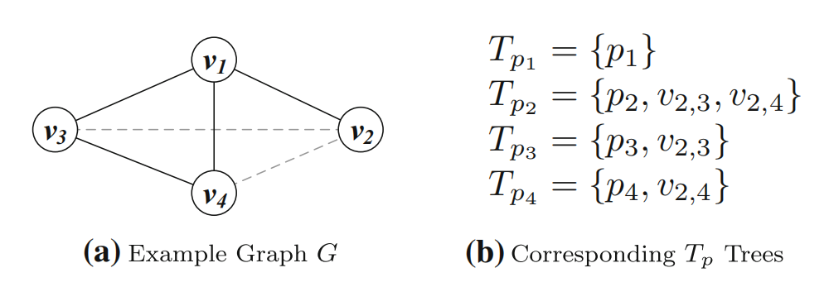
kDSP Complexity
Problem Definition
Example

Slide 64
k-Proportional Semantic Places
kPSP Problem: Given a query location and its result S returns a set R of k place entities that have the highest HPf(R) score, where:
The proportionality components pC (contextual), pS (spatial) rely on knowledge of the wider area around the query
Calculation can be expensive

Slide 65
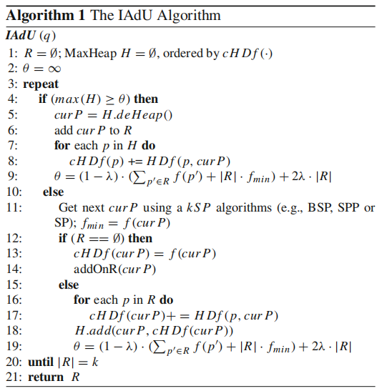
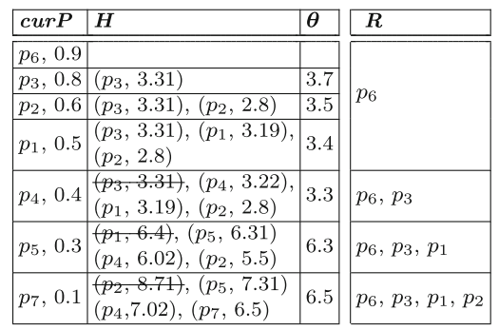
IADU Algorithm
Incremental Addition and Update Algorithm
Example
Complexity of the algorithm is
O( K · (kSPT + k · logK + K))

Slide 66
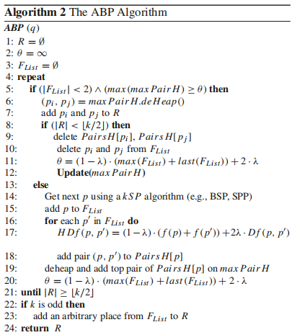
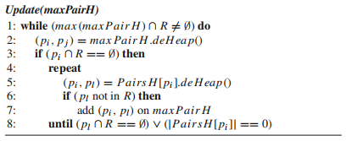
ABP Algorithm
Add Best Pair Algorithm
max Pair H is updated in a
lazy fashion in order for the currently best pair on the top of
this heap to be a valid pair (function Update()).

Slide 67
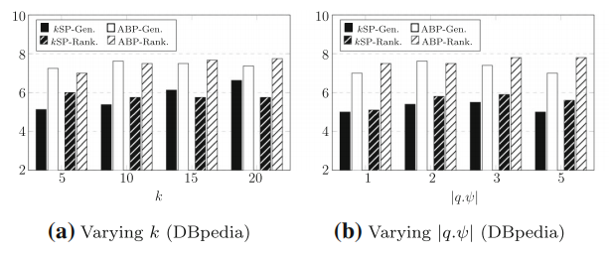
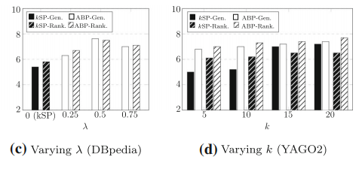
User Evaluation

Slide 68
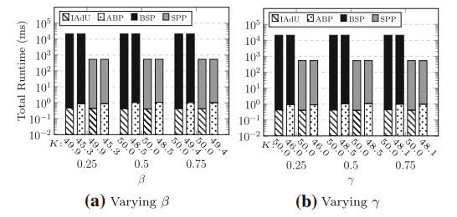
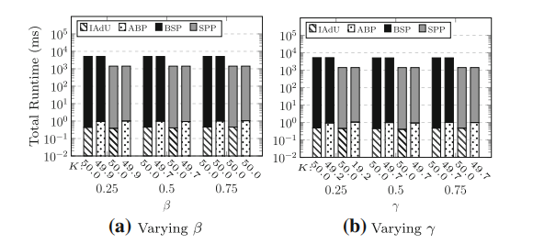
Efficiency Evaluation
DBpedia
YAGO
Notes:
Parameters beta , gamma do not seem to affect performance

Slide 69
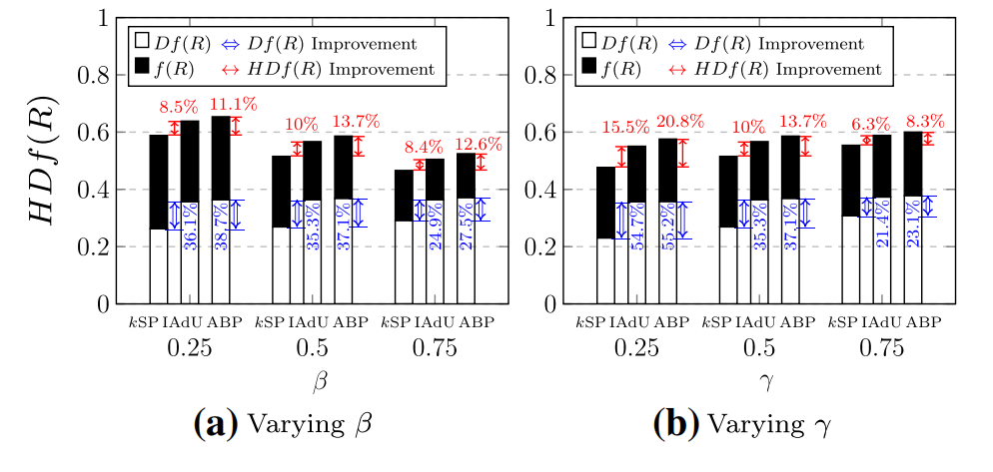
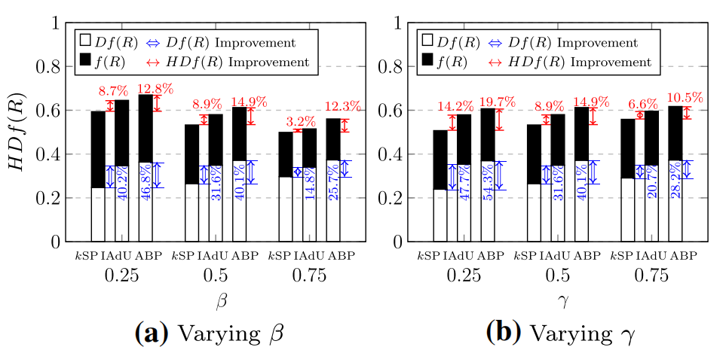
Effectiveness Evaluation
DBpedia
YAGO
Notes:
as γ increases, the improvement gap drops
Larger
γ values give higher weight to content diversity and since
it is easier to find diverse results in terms of content than
in the 2-dimensional space of locations, the results of kSP
and IAdU have higher chances to find more diverse place
sets.
Beta expectedly mostly affects

